Slide 1
JOB SEARCHING
The Office of Career and Professional Development
Notes:
Hello, welcome to The office of Career & Professional Development. Thank you for joining us today for this presentation on Job Searching tips and tricks

Slide 2
JOB SEARCHING
It is more than utilizing job searching platforms to search for open positions.
Notes:
Job searching is not as straight forward as you might think. There is a lot to the job searching process and it actually goes hand in hand with networking and career exploration.

Slide 3
JOB SEARCHING & NETWORKING
Glassdoor
Indeed
CareerShift
LinkedIn
Monster
Idealist.org
Handshake
Some open positions may never reach these platforms. Networking is key, and it is part of the job search process.
Notes:
You never want to rely on one or two job searching platforms when navigating your search. Companies are not utilizing every platform that is out there so if you are only sticking with your favorite, you could be limiting yourself tremendously. Additionally, some companies utilize many different platforms but are strategic when it comes to which position they are posting to which job board.
The list you see on this slide is an example of popular job boards. There are more out there.

Slide 4
CAREER EXPLORATION
Informational Interviews
Industry Research
Company Research
Notes:
It is never too late to explore a different career path. Many people are currently rethinking their careers and what they want to do next. Maybe you have always had a passion for a certain industry or career path but it never lined up. Now could be the perfect opportunity to explore that path again.

Slide 5
INFORMATIONAL INTERVIEWS
UAlbany Alumni (UCAN)
LinkedIn Connections
Faculty/Staff
Family Friends
Relatives
Notes:
Once you have an idea of the career path you want to pursue, you should try to obtain as many informational interviews as you can. However, you want to be strategic about who you are choosing to interview. Above are a list of individuals that could provide you with strong insights into the field you are interested in. Be aware that everyone comes to the table with their own perspectives. Try not to rely on one person’s impression of the field. It is extremely helpful to interview people across industries and career levels to obtain a more well-rounded image.

Slide 6
INDUSTRY RESEARCH
Health Care
Manufacturing
Business
Information Technology
Accounting
Legal
Media
Notes:
There are many different career paths that traverse multiple different industries. Think of human resources, accounting, marketing, etc. If you want to pursue any of those as a career you might be thinking that you have to work for an accounting firm or a marketing company. That is not the case. Every company and every industry needs an accountant or marketing or HR professional. With that considered, you might want to look into a diverse set of industries and see if your personal and professional interests can align with that industry.
Maybe you love the Health Care industry but you don’t want to be a doctor, nurse, physician assistant, etc. You can take you passion for Human Resources, for example, and apply that within the Health Care industry and get the best of both worlds.

Slide 7
COMPANY RESEARCH
Where It Can Be Done
Company Website
Glassdoor/Indeed
LinkedIn
Social Media
Handshake
Factors To Consider
Connections Through Shared Values
Company’s Benefits Plan
Company’s Leadership
News Articles
Network Connections
Notes:
Once you have done your industry research and identified the industries that you are most interested in, it is time to look into the different companies within that industry. One of the main benefits to researching a company is to understand the companies values and mission. If you can align your personal values with the values of the organization you work for you have a higher chance of finding happiness and true satisfaction in the work you will be doing.

Slide 8
JOB DESCRIPTION ANLYSIS
Read through the whole description
Highlight the pieces of the job responsibilities that interest you
Highlight the pieces of the qualifications that you match/could obtain prior to or shortly after starting
Look at the proportion of highlighted to non-highlighted portions
Notes:
Finally, it is time to break down job descriptions. Once you have identified some job openings you are interested in you want to thoroughly read through the description to ensure you are finding the best fit based on your experience and interests. On this slide you will find some helpful tips to assist you in determining if that job is the right fit for you.

Slide 9
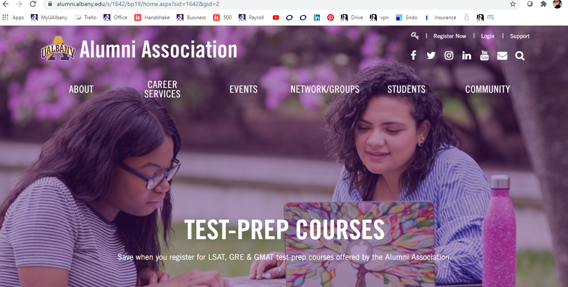
Alumni who have graduated more than 5 years ago, can contact Alumni Association for career questions and assistance
https://www.alumni.albany.edu/s/1642/bp19/home.aspx?sid=1642&gid=2

