Slide 1
How to Construct a Cover Letter
JOSEF KORBEL SCHOOL OF INTERNATIONAL STUDIES

Slide 2
What is a Cover Letter?
What a Cover Letter Should Do
Statement of Interest vs. Cover Letter
It should convince the reader of 3 main things
You want the job and want to work for their organization
You have the skills and the knowledge to do a great job
You're a fit for the job and the organization
A letter of interest is not the same as a cover letter
A cover letter is responsive to a certain job requirement while a letter of interest is an inquiry of a position
A cover letter has more guidelines
Similar construction

Slide 3
Structure
Header
Salutation
Introductory paragraph
Demonstration of your relevant expertise
Concluding paragraph

Slide 4
Header and Salutation
Date
Name (CAUTION: make sure you know if its a Dr., Ms., or Mr. and be 100% certain of their gender)
Title
Organization
Address
City, State, Zip
--------------
Dear [Name, or Hiring Manager, or Hiring Committee],

Slide 5
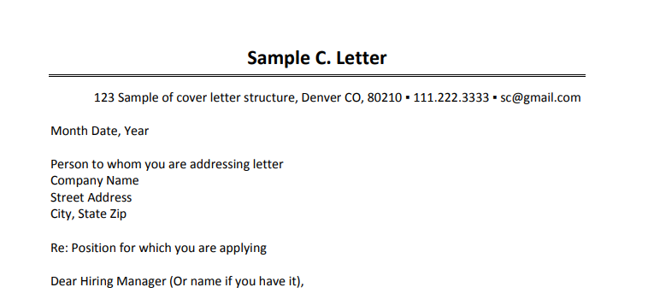
Example

Slide 6
Introductory Paragraph
What are you applying for?
"Please accept my application for..."
"I am writing to apply to..."
Hook
"I learned about this internship from your board member, Dr. Charlene Albee."
"I saw this position posted through the Josef Korbel Career Center."
"For the last several months, I’ve been visiting your Website regularly and viewing your posted internships; I was excited to see the Global Health research internship that was just posted because..."
Connect yourself to the organization or job
"I was drawn to this position because I’m specifically seeking the opportunity to make a difference in the lives of women and children."
"I have been following the work of your organization since my undergraduate studies when I wrote a research paper on mining and used the database you make available on your Web site."
"My ultimate career goal is to... and through a research internship with your organization, I want to further develop expertise in... and skills in..."

Slide 7
Please accept my resume for the Research and Evaluation Specialist positionI learned about from the Josef Korbel School of International Studies’ Career Office. I was excited to see this vacancy announcement because I’m seeking aposition where I can use both my analytical skills and extensive cross-cultural experience to help ensure interventions that create income and livelihood opportunities for poor rural households. Your organization’s mission to improve water access and help rural farmers increase their livelihood is in line with what I have been researching and implementing in graduate school.
Introduction Example

Slide 8
Body Paragraphs
You will need 2-3 body paragraphs
Name the relevant skills and knowledge.
Have a "thesis" statement either at the end of the introductory paragraph or the beginning of the first body paragraph that explain the skills you will discuss in your cover letter
Example: "As a first-year student completing an M.A. in Global Finance, Trade and Economic Integration at the Korbel School of International Studies, I have developed strong quantitative and analytical skills and am eager to put these to practice to contribute to your research project."
Demonstrate your named skills through a developed example.

Slide 9
STAR
Situation - the background, set the scene and give necessary details of your examples
Example: Group class project looking at trade relations between China and Africa
Task - Describe your responsibilities were in the situation
Example: Find and analyze data, write a group paper and make a group presentation
Action - Explain exactly what steps you took to address it
Example: My role was to find data sources, use STATA and Excel, and draw conclusions. I also wrote and presented on the methods section of the paper.
Result - Share what outcomes your actions achieved
Example: Our team received the highest grade in the class and I was recruited by my professor to be her research assistant the following quarter.

Slide 10
I would bring project management experience and my proven ability to gain the trust of local communities to this project. For example, as Regional Assistant in Panama, I quickly realized that before I could jump headfirst into projects, I needed to first develop relationships with my coworkers. This meant taking the time to talk to them about their families, their plans for the organization, and their lives, while also sharing information about myself. With the trust of the group, I effectively managed the six-person local team to successfully run the office while developing new projects and organizational structures. These included new budget management plans, database systems, work plans, and communication strategies to liaise between the Panamanian team and the U.S. branch of the organization. With the support of the local team, we developed relationships with subsistence farmers in surrounding communities, developing the first regional Farmers Fair Trade Association.
Body Paragraph Example

Slide 11
Concluding Paragraph
Keep it short
Summarize interest
Example: Again, I am pursuing this position specifically because of the exciting opportunity to use mystrong intercultural communication skills to work with indigenous populations in the field.
Address any requested inforamtion
Example: I would be available between June and August to complete this internship.
Say thank you
Example: Thank you for your consideration of my application...
Follow up
Example: I look forward to interviewing with you and the entire search committee and will contact youearly next week if I haven’t heard from you.

Slide 12
I have attached my resume and am available for an in-person interview within short notice. My salary requirements are flexible and would depend on the benefits package. I will be graduating in June, relocating to Washington, DC and will be available to start immediately thereafter. I look forward to hearing from you soon. Thank you for your consideration.
Concluding Paragraph Example

