Slide 1
The New Normal: Job Hunting
Spring 2020
Brian Hirsch, Ed.D.

Slide 2
Sheldon Interviews for a Job

Slide 3
Special Guest: Bethany Cooper
Corelogic

Slide 5
The Career Center is Open
50+ Virtual Events Listed in Handshake
Use handshake to find jobs, networking events, career planning workshops, and employer information sessions. https://unt.joinhandshake.com
Handshake – Get Hired Remotely Resource Page https://learn.joinhandshake.com/students/category/get-hired-remotely/
Recorded Workshops/Events https://careercenter.unt.edu/resources/virtual-workshops-and-events/
Career Center Resource Page https://careercenter.unt.edu/resources/virtual-career-center-services/
RCOB Career Center Site https://careercenter.unt.edu/channels/business/

Slide 6
Headwinds
COVID 19 and Economics
Things we cannot control

Slide 7
Our Sphere of Control

Slide 8
Poll: Planned Happenstance

Slide 10
Planned Happenstance
Planned Happenstance can be framed as the idea to create chance events that turn into actual opportunities.
curiosity to explore learning opportunities.
persistence to deal with obstacles.
flexibility to address a variety of circumstances and events.
optimism to maximize benefits from unplanned events.

Slide 11
Planned Happenstance
Preparation
Your Goals
What You Want to Offer
What They Need
Practice
Communication
Be Open
Be proactive and look for opportunities
Don’t dismiss something because it does not meet your expectation
Be positive
Be curious and take action
Network
“…planned happenstance theory then is all about being more conscious, purposeful and adapting to on-going process of career development that can help to build a more satisfying and fulfilling career.”

Slide 12
Known vs. Hidden Job Market
Known Market
Job is defined
Candidate specs defined
Company need = fill job
Contact point = HR or agents
Focus is on candidate
Success = matching specs
Hidden Market
Job often undefined
Candidate specs fuzzy
Company need = solve problem
Contact point = line or functional management
Focus is on company
Success = solving problems

Slide 13
Hidden Job Market
Do your homework
☹ Research
It’s a process
Messaging (more on this later)
You make the first move
How Can You Use the Idea of the Hidden Job Market to Move Your Search Forward?

Slide 14
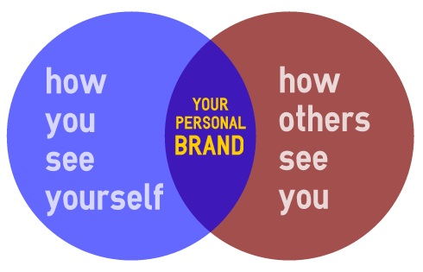
Messaging aka Personal Branding
The totality of what is presented to a consumer or audience
It’s verbal
It’s non-verbal
It’s in-person
It’s online

Slide 15
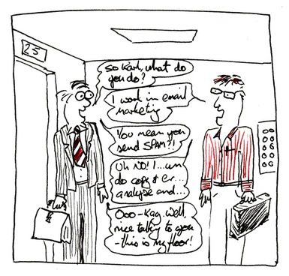
Activity: Write Your Elevator Speech/Intro

Slide 16
What is your message?
Who is the audience
What is the message about
Skills
Experiences

Slide 17
….And Now There is AI
Predictive Algorithms
Machine Learning
Being used in the early part of the application process to narrow the applicant pool
Chatbots are becoming more common
Companies are using AI to assess human qualities, drawing on research to analyze everything from word choice and microgestures to psycho-emotional traits and the tone of social media posts.
http://fortune.com/2017/05/19/ai-changing-jobs-hiring-recruiting/

Slide 18
Targets
What are the companies and industries of focus
Healthcare
Social media
Hand sanitizers
Zoom
On-line education
Peleton - fitness
Digital health
Flex jobs

Slide 19
Networking
who should you connect with
adopting a community mindset - job search group
communicate skill sets
tell contacts what you need, how can they help you?
share accomplishments especially as they cross-over to thework thecontact needs done
communicate the value of skills

Slide 20
Networking Resources
LinkedIn
Coming soon…Mean Green Mentors

Slide 21
Job Searching Resources
Handshake
LinkedIn
Looking for other opportunities? Check out posts with #NowHiring. You can also use that hashtag in your posts about open positions.
Wall Street Journal “Who’s Hiring” https://www.wsj.com/graphics/whos-hiring-whos-firing-how-firms-are-reacting-to-coronavirus/?mod=theme_coronavirus-ribbon
Professional Associations
Flex Jobs
Micro Internships - https://www.parkerdewey.com/career-launchers
https://www.flexjobs.com/ (disclaimer they charge a monthly fee)
We Work Remotely https://weworkremotely.com/
Remote OK https://remoteok.io/
Upwork https://www.upwork.com/

Slide 22
Final Thoughts
Stay Positive
Make a Plan
Prepare/Research
Network
Be on the lookout for opportunities
Create opportunities for yourself
Follow-up

Slide 23
The Career Center is Open
Contact us directly:
Brian Hirsch – brian.hirsch@unt.edu
Destiny Price – destiny.price@unt.edu
Dee Wilson – dee.Wilson@unt.edu
Beth Kent – beth.kent@unt.edu
(940) 369-7238
OR Request an appointment in handshake

