Slide 1
Job Searching 101!
Network Your Way to a Job

Slide 2
Agenda
Review “My Professional Brand” Assignment
Who is already in your network?
How can you expand your network?
Informational Interviewing
Alumni Mentor Program
Review Action Steps

Slide 3
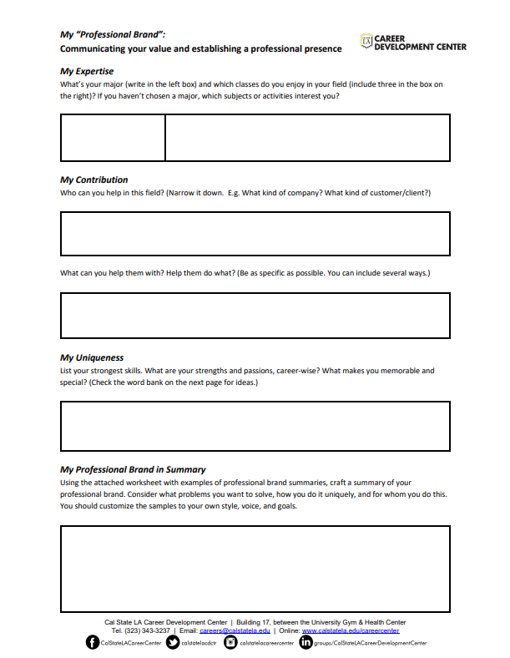
My “Professional Brand”
Review
Expertise
Contribution
Uniqueness

Slide 4
What do you find challenging about networking?

Slide 5
5 Myths about Networking!
1
2
3
4
5
The more contacts you have the better
You need to know your career plan to do it
Introverts are at a disadvantage
It should be done in-person
Networking only works when it gets you a job

Slide 6
Discussion: What did Fedhii do in order to network his way to a job?

Slide 7
Fedhii’s Networking Journey…
Utilized his network
Reflected and Focused on his Passions
Applied to internship
Found Alumni Mentors
Began expanding network
Learned about various industries and jobs
Started using LinkedIn
Connected with People

Slide 8
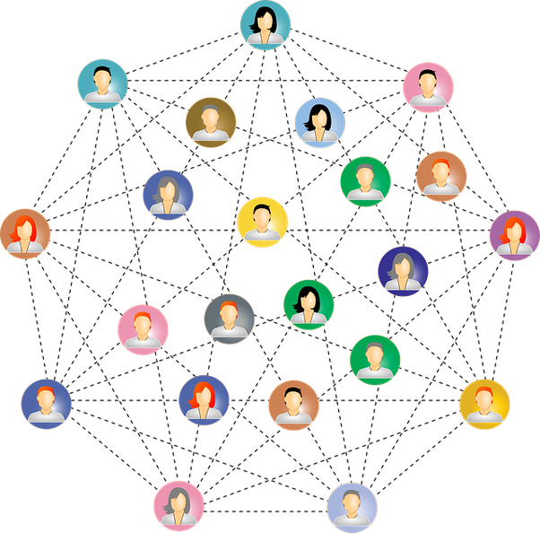
If you were to do some networking this week, who would you reach out to?

Slide 9
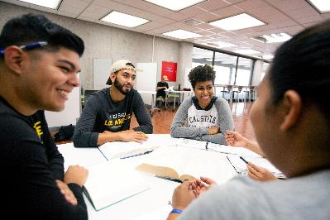
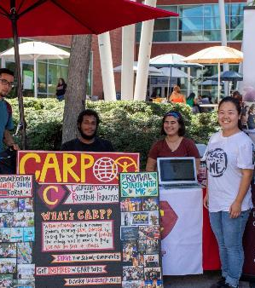
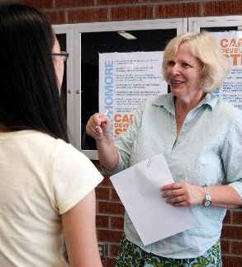
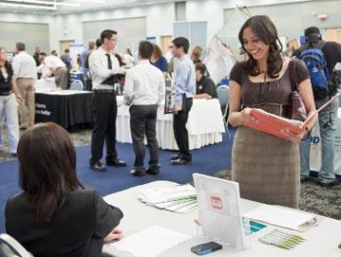
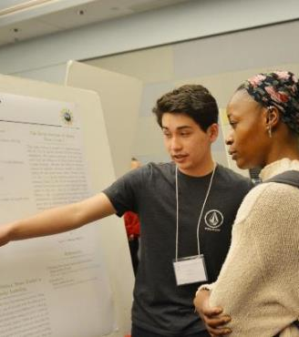
You already have huge network!
Student Organizations
Friends & Family
Faculty & Staff
Employers
Alumni
Local Community

Slide 10
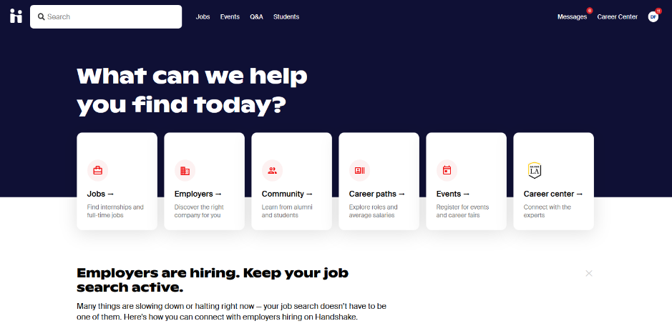
How can you expand your network?
Cal state la

Slide 11
Myth 5: There’s Nothing You Can Do
What is an informational interview?

Slide 12
How to do an Informational Interview
1
2
3
4
5
Reach out to professionals you have a connection to
Send a brief email requesting to ask them a few questions about their job
Setup a virtual meeting or phone call
Prepare questions to ask
Thank them and return the favor

Slide 13
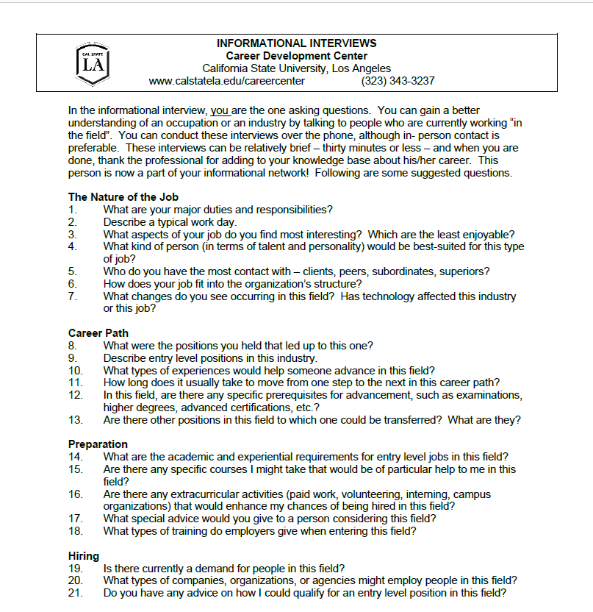
Informational Interviewing is for everyone!

Slide 14
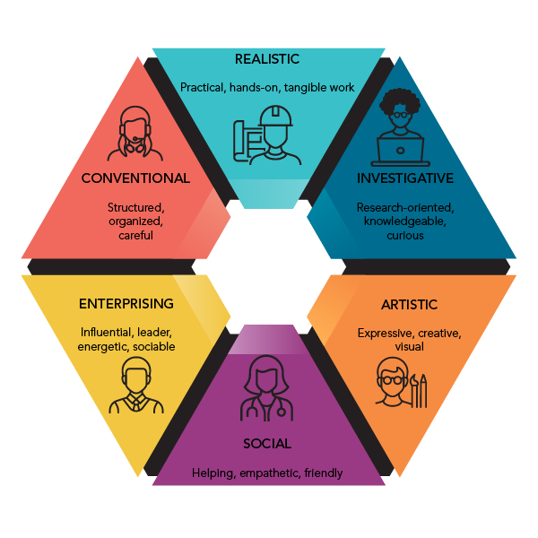
R
What’s your 2 or 3 letter
Holland Code?
C
I
A I
__ __
__ __ __
A I S
A
E
S

Slide 15
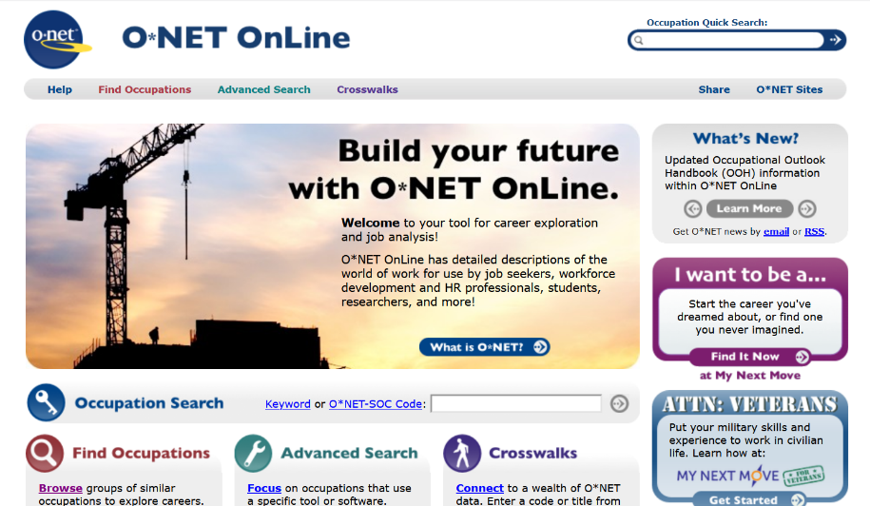
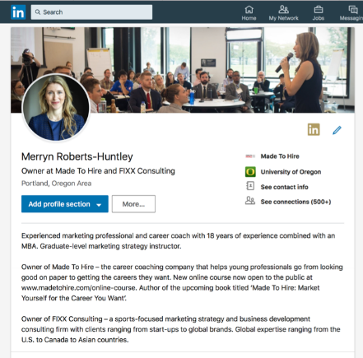
How can we use our Holland Code to expand our network?

Slide 16
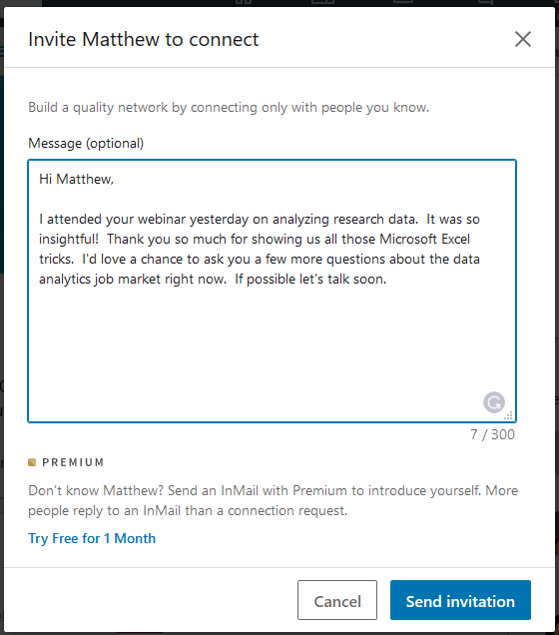
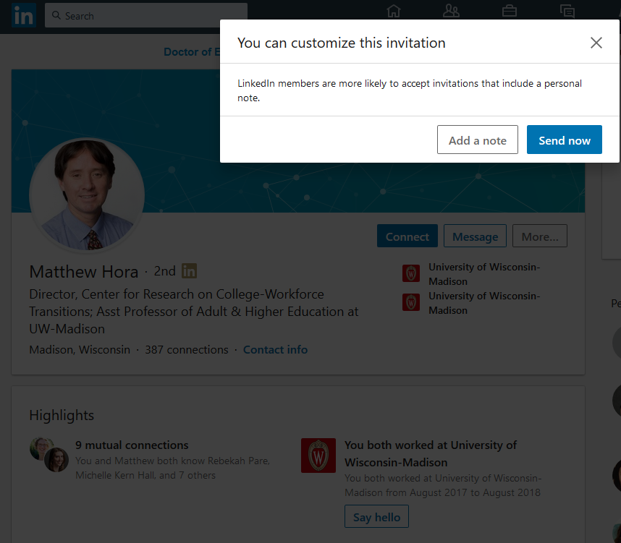
Request to Connect Message
LinkedIn Connection Request Templates

Slide 17
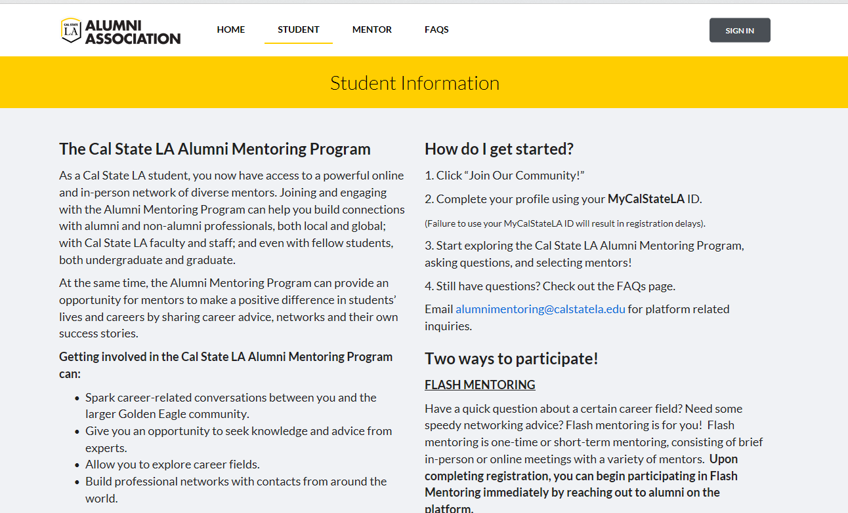
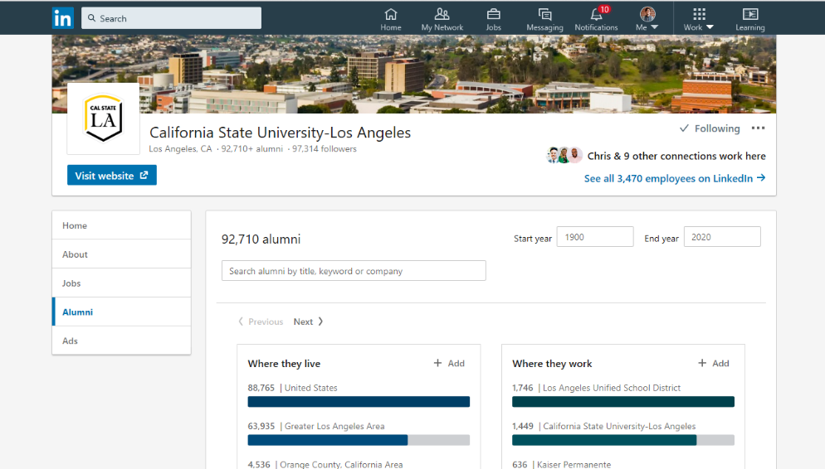
Ways to Reach Out to Alumni
Alumni Association Mentor Program
Alumni feature on LinkedIn
Notes:
Discuss the different styles and interview attire and how interviewees in different industries tend to dress differently
Ask students if they have interview clothes or need to find

Slide 18
Action Steps
Talk to someone in your existing Network (Cal State La & local community)
Learn about occupations that relate to your Holland Code on ONET
Expand your network on Handshake and LinkedIn (send a message and connect)
Request to do an informational interview with someone
Join the Alumni Mentor Program
Notes:
Discuss the different styles and interview attire and how interviewees in different industries tend to dress differently
Ask students if they have interview clothes or need to find

Slide 19
Any Questions?
Notes:
To use this title animation slide with a new image simply 1) move the top semi-transparent shape to the side, 2) delete placeholder image, 3) click on the picture icon to add a new picture, 4) Move semi-transparent shape back to original position, 5) Update text on slide.

