Slide 1
10 Rules to Building Your Professional Image at Your Internship
Ashley Pedersen, Internship Resources Consultant
Center for Career Development

Slide 2
Congratulations! You’ve got an internship. You’ll be in a work environment where you’ll learn new skills, make new connections, and get hands-on experience in a career field you’re interested in. Now is a great time to start thinking about your professional image.
A… what?
A professional image.
Professional image, n. : The characteristics and reputation you set for yourself in a professional environment that encompass your skills and personality as they related to working.
It’s how your coworkers, boss, or clients perceive you. It’s what you say, do, and write.
Why is it important?
Building a good professional image as an intern can set you apart from other interns, make you look more employable to the company, and help expand your professional network.

Slide 3
10 Rules of Building a Professional Image
Be Punctual
Dress for Success
Be a Self-Starter
Be Prepared
Network
Make Working with You Easy
Write Professionally
Ask Questions
Act Invested
Leave the College Life at Home

Slide 4
#1 Be Punctual
“If you’re early, you’re on time. If you’re on time, you’re late”
It’s first because it’s easiest. Be on time. If your alarm didn’t go off, let your boss or someone know you’re running late. If you’re sick, promptly call in. Be one of the first people in the room for a meeting or event. People respect others who respect their time and are accountable.
Source: http://capnjohnsblog.blogspot.com/2012/04/punctuality.html

Slide 5
#2 Dress for Success
“Dress for the job you want”
Look professional at all times and abide by the company’s dress code. Wear ironed, clean clothes and footwear that make you look like you want to be taken seriously and are ready for the job ahead.
Learn what office dress protocol is. And don’t interpret casual Friday dress as wearing nicer sneakers.
Source: http://www.tvfanatic.com/quotes/shows/the-office/episodes/casual-friday/page-4.html

Slide 6
#3 Be Prepared
“Be prepared!!!” – The Lion King
Bring a pen and notebook with you to all meetings, even if it’s an unscheduled check-in with your supervisor. It shows you are expecting to learn or take away something from the conversation, and that you care. It’s also easier than simply remembering what your boss asked you to do.
Are you taking notes?
Source: blogs.disney.com

Slide 7
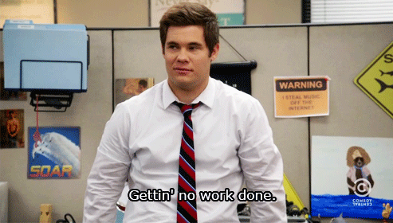
#4 Be a Self-Starter
“Look busy, the boss is coming!”
Take advantage of down time by showing you were worth the organization’s investment in selecting you. Ask a colleague if they need help with a project. Research the company or industry. Brainstorm project ideas for yourself, and bring them to your boss. Ask for more work, if you can manage an increased workload. Ask a colleague if they need help with a project Check in with your supervisor if you’re underwhelmed or overwhelmed. They will appreciate you being communicative, especially if your communication is that you’d like more responsibility.
http://little-blvck-submarines.tumblr.com/post/46272372100

Slide 8
#5 Network
“It’s all about who you know”
If rules could be duplicated, it would be rules 6, and 7, too. Take full advantage of your daily opportunity to grow your professional network. What’s networking? It’s grabbing coffee with fellow interns to share experiences. Having lunch with full time colleagues. Asking your boss about their career path. Networking doesn’t have to be formal or awkward, it’s all about learning about the people around you and creating connections. It’s about At the end of your internship, connect with these folks on LinkedIn. Get their business cards. Stay in touch, and be sincere in your interest in staying connected with that person. You never know who can help you along to your next career move.
Source: http://www.diydancer.com/2013/06/10/dance-as-a-business-part-ii-networking

Slide 9
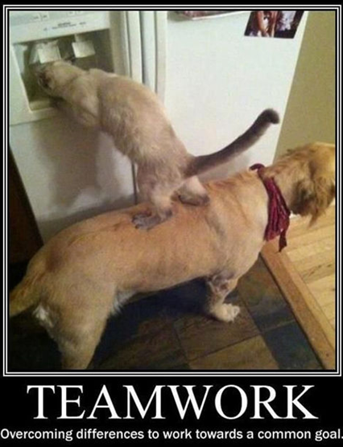
#6 Make Working with You Easy
“You can count on me”
Be dependable and flexible. Go above and beyond to show you are a team player by stepping up to challenges or situations that call for it – like being the meeting note-taker or staying late to finish up a project, if you can. Come through on your commitments but avoid overpromising when you know you can’t deliver. If you can’t do the report until Thursday, don’t tell them you’ll have it Wednesday. The easiest way to be a good team member is to come through on your deadlines, respond to e-mails and voicemails in a timely manner, and communicate often.
Source: http://sunnylol.com/overcoming-differences-by-teamwork

Slide 10
#7 Write Professionally
“I just LOL’ed”
Your e-mail etiquette is just as important as your table manners. Be sure to include greetings, salutations, correct punctuation and good grammar in your e-mails as they’re a reflection of you professionally. Stay away from emoticons and other expressions. And never, ever LOL.

Slide 11
#8 Ask Questions
“There’s no such thing as a dumb question”
Your internship is a learning opportunity. Take advantage of the knowledge of those around you by asking thoughtful questions. Whether it’s needing clarifications on projects you’re assigned, or how to use new technologies or computer programs, or not understanding an assignment, ask. Supervisors are more receptive to a few extra minutes of you asking for clarification, rather than a few extra hours fixing a problem created through a misunderstanding.
http://www.helpingchurchleaders.com/wp-content/uploads/2011/04/question.jpg
http://www.vapartners.ca/wp-content/uploads/2013/04/Value-Proposition-Asking-Questions.jpg

Slide 12
#9 Act Invested
“Invest in your future”
Create a good professional image for yourself, and you won’t have employees thinking, “Oh, he/she is just an intern.” You were brought on board to contribute to the organization, and as they’ve invested in you by giving you the opportunity, you need to portray that you’re part of the team. Participate in social outings or team lunches. Learn about all aspects of the organization, not just your department or role. Do your work with the same amount of energy, thoughtfulness and attention to detail as you would a full-time position. Show that you’re invested in the company during the internship, and they might consider you full-time material.
Source: http://sigmaism.com/internship-movie-review/

Slide 13
#10 Save the College Life for Campus
“Did you see what they just posted on Facebook?”
No, you didn’t, because you’re at work and would never Facebook on the company’s time. Or dollar. And you haven’t posted what you ate for lunch on Instagram, because you were too busy talking with the managing director about her first job out of college – not about that really bad hangover last week. If you expect to be treated like more than an intern, treat the experience as a professional one. An important rule of thumb in any professional environment is to leave your personal life at home. And for an internship, leave the college stuff for campus and bring your “A” game with you to work.
Source: http://www.troll.me/2012/04/13/creepy-willy-wonka/oh-you-have-a-summer-internship-tell-me-more-about-it-on-facebook

