Slide 1
Pre-Law at Penn
Slide deck
What you need to know: Penn Freshman and Sophomores.
Notes:
10-15 minutes aim for presentation

Slide 2
Table of contents.
01
02
03
04
Joining organizations
Opportunities to give back
Resources to check out
Classes and majors to consider
Slide 4
Slide 9
Slide 14
Slide 18

Slide 3
Disclaimer
Hi, I hope you are doing well and taking care of yourself. I know you may be anxious or overwhelmed regarding your or other people’s expectations of what being pre-law is supposed to look like. You do not have to do “pre-law” extracurriculars and take typical “pre-law” classes to be pre-law. You are doing fine and everything will be okay. Just breathe…
Joy Olatunde

Slide 4
01
Guide on extracurriculars.
Things to have in mind

Slide 5
When evaluating/joining orgs
Friendship
Community
“Pre-law”
Joining organizations is a great way to make friends and build your community at Penn. An organization where you feel that you belong is a great one!
Your community at Penn is what you make it. Intentionally surrounding yourself with likeminded people is always beneficial and orgs are a great way to do that.
There is no mandatory organization that will make or break your law school application. Being Pre-Law is like life, it is whatever you want to make it.

Slide 6
Helpful “pre-law”skills to develop
Commitment
Leadership
Impact skills
Being a consistent member or leader of an organization is a great way to show that you are committed on law school applications. This is easier to do with clubs that you genuinely enjoy.
Leadership positions and roles in organizations help you develop professional skills. These skills include experience with being a part of a team, problem solving, creativity, communication and other professional skills that will be helpful on campus and beyond.
Experience in organizations on/off campus will help you develop impact skills. The ability to make a difference in a community albeit it Penn or the West Philadelphia community, will help you develop team building, leadership and social skills.

Slide 7
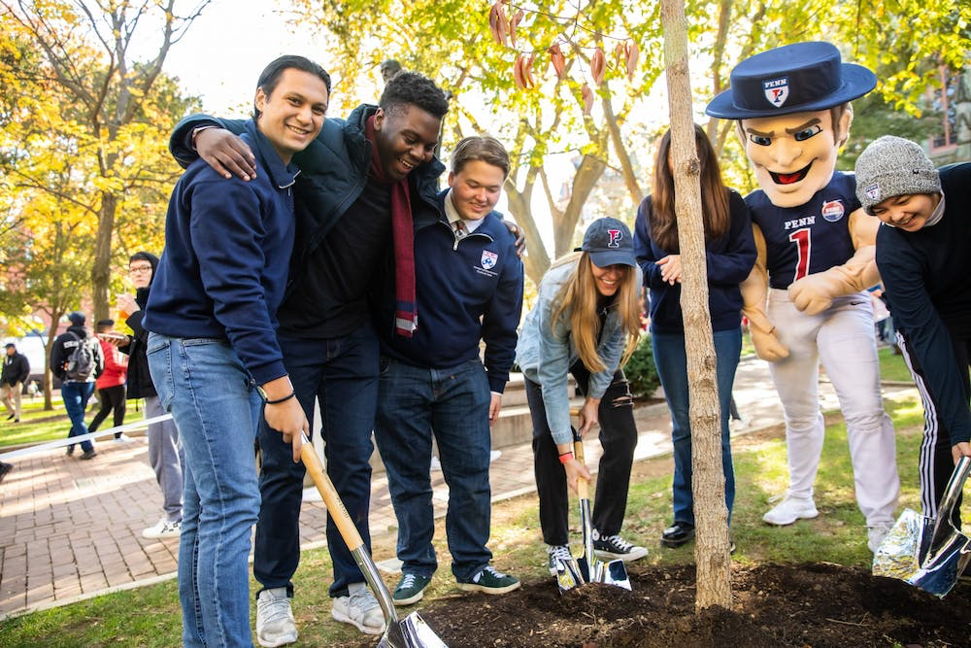
Impact
The organizations you join will have a big impact on your experience at Penn so make sure you commit to clubs intentionally. Orgs are also a great way to impact Penn culture as a whole and make your mark on campus.

Slide 8
Some extracurriculars to consider
Pre-Law associations
Includes Black Pre-law at Penn, John Marshall pre-law honor society, Penn undergraduate Law journal, etc.
PSG
Politics
Law
Government
Penn Student Government
Includes Penn Democrats, Penn College Republicans, Penn political union, Penn for Justice, etc.
Includes the Undergraduate Assembly, Class Board, Nominations and Elections committee, Student Activity Council, Social planning and events committee and Student committee on Undergraduate education.

Slide 9
02
Guide on Academics.
How important is GPA? Recommended classes for Pre-law students

Slide 10
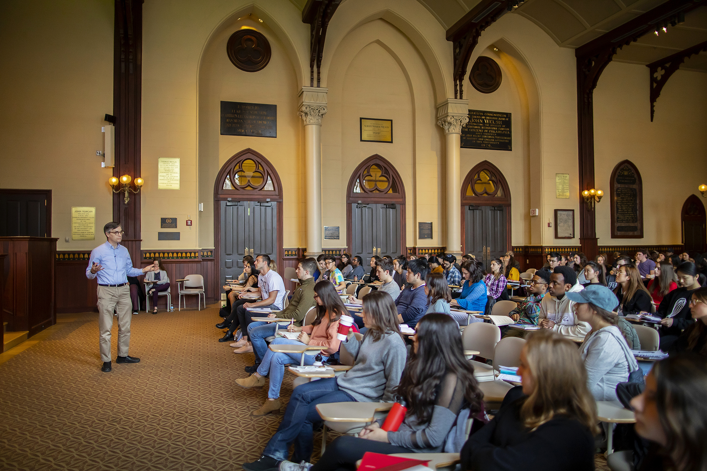
No required major or classes
The pre-law path is unique in the fact that there is no required major or prerequisites for applying to law school. Feel free to explore your academic interests and major in discipline that you enjoy.

Slide 11
GPA is not everything
The following are some of the things to focus on while choosing classes and thinking about your grades.
Interest
Challenge
Resources
Take classes that are interesting to you or topics that you would enjoy learning about. This is the time to explore your academic interests!
The majority of classes at Penn are designed to challenge you and teach you something new. It is okay to earn grades that are not A’s.
If you find that a course is too challenging or difficult to understand, go to office hours or speak to your TA. They are there to help you.

Slide 12
Legal studies and History
Legal studies is a common minor among Pre-Law students at Penn. Below are some of classes to familiarize you with the minor
Law and social values(Lgst 1010)
History of American law since 1877(Hist 1169)
Law and business ethics (Lgst 1000)
This course offers a historical analysis on well-known law cases like the slaughterhouse cases, roe v. wade, etc which set legal precedent in the United States.
This course explores the ethical requirements for corporations and the legal implications of unethical businesses.
This course is a great introduction into various fields of law including Tort, Property, Constitutional and many others.

Slide 13
03
Volunteering at Penn.
How to help others and have impact both on and off campus
Notes:
Netter center, The petey greene program, Pure (refugee empowerment org at penn), ABCs courses, Civic house-civic scholars program, apply to during freshman fall

Slide 14
Civic House
Civic Scholars program
Community engagement Internship
A group of undergraduate students with a four-year experience integrating community engagement and scholarship. Including seminar, engagement experiences and bonding with the yearly cohort. The application for this program is due the fall of your freshman year.
Civic house provides funding to Penn undergrads to support academic year-long or summer internships at community partner organizations. These orgs include Bread and Roses community fund, Public citizens for children and youth, Philadelphia Legal assistance, etc.

Slide 15
PRE(Penn undergraduates for refugee empowerment)
PRE is a student organization at Penn. PRE’s mission is to empower refugees through education assistance and to foster a welcoming community for refugees in Philadelphia. PURE works closely with resettlement centers, cultural groups and organizations around the world. To volunteer with the African Family Health Organization in West Philadelphia,
contact Lauren st. Louis at Lstlouis@sas.upenn.edu.

Slide 16
Netter Center
The netter center for community partnerships conducts ABCCS- Academically based community service courses that are connected to research, learning and teaching about real-world problems and their solutions. The organization also conducts University-assisted community schools, (UACS) that serve public school students by bringing aBCS courses to West Philadelphia Schools.

Slide 17
The Petey Greene program
The Petey Greene Program supports the academic goals of incarcerated and formerly incarcerated people through high-quality volunteer tutoring programs. Our tutoring programs provide high-quality, individualized tutoring and academic support that every learner needs to achieve their educational goals.

Slide 18
04
Resources.
A few helpful resources to make life a bit easier

Slide 19
Career Services website resources
Resume review by a current law student( Free for life, even after graduation).
Pre-law advising appointments with Career services (Free for life, even after graduation).
Appointments with Pre-law Peer Coach of Career services.
LSAT-lab discount.
Live Career Tools series- (free for life, even after graduation).

Slide 20
Academic resources
Marks Family writing center
Weingarten learning center
The writing center is a great help for your writing assignments. You can make appointments with a writing tutor that will fit with your schedule and get help with outlining, writing, or proofreading your papers.
Weingarten is the hub at Penn for academic support and Disability services. If you need help with tutoring, time-management skills, accommodations of any kind, Weingarten is the place to go.

Slide 21
Good Luck!

