Slide 1
Career Services
Summer Funding
Program Overview, Application Tips & FAQs

Slide 2

What is Summer Funding?

Slide 3
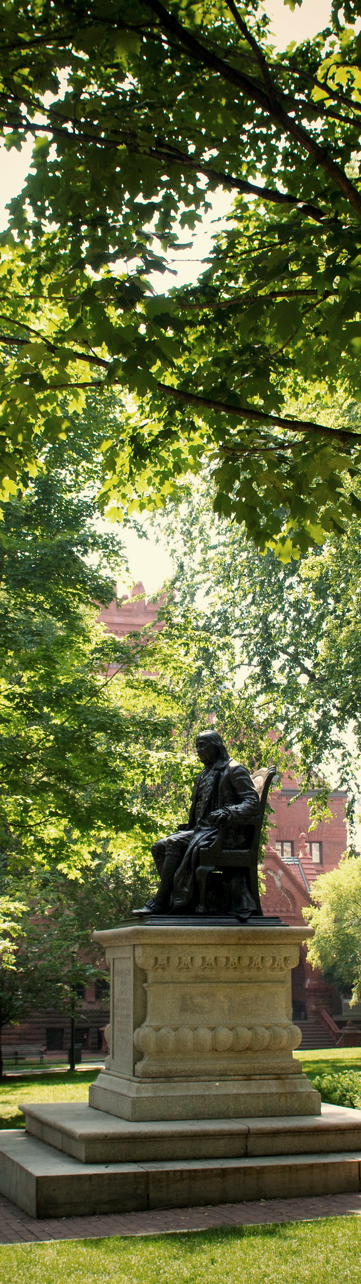
What is Summer Funding?
Many internships/research opportunities are unpaid or only provide a small stipend
Some summer opportunities may be in cities where the cost of living is high
Career Services has funding for a limited number of students pursuing unfunded or underfunded summer opportunities – this comprises our Summer Funding program
These funds (up to $5,000) can cover travel expenses, living expenses or other expenses related to a student’s summer experience

Slide 4
Who Is Eligible?

Slide 5
Who Is Eligible?
In order to apply, you must meet all the following eligibility requirements:
  Currently a full-time undergraduate student at Penn
  Graduating in December 2024 or later
  Receive financial aid from Penn
    If you are a Highly-Aided student, please apply for summer funding directly through Student Registration and Financial Services (SRFS)
Note: no documentation is required to apply (applicants can be U.S. citizens, permanent residents, international students, DACAmented students or undocumented students

Slide 6
Who Is Eligible?
In order to apply, your summer opportunity must meet all of the following eligibility requirements:
  You must have an offer already (but you do not need to have accepted it at the time of application)
  Internship, service program or research opportunity
    Summer classes are not eligible
    At least 8 weeks long
    At least 30 hours per week
    Does not require a fee to participate
Note: you can only apply for one Summer Funding opportunity

Slide 7
What Do I Need to Apply?

Slide 8
Summer Funding Requirements Include:
Resume
Personal Statement
Detailed Budget
Summer Experience Offer Letter/Email

Slide 9
Resume
Provides information for the summer funding committee on your previous experiences to understand how your Summer 2024 opportunity aligns with your career goals
Recommended length: 1 page
  Use your judgment if you can't fit everything on your resume
Recommended font size: 10pt – 12pt
Avoid small margins: .5 inches to 1 inch recommended
Strongly recommend using a simple format – review Career Services website for guidance
All information submitted must be accurate and truthful!
  Do not exaggerate or embellish any information on your resume or other summer funding application materials

Slide 10
Personal Statement
No more than 450 words
Be sure to address the following:
  Clearly state the internship/research opportunity and whether it is unfunded or underfunded
  Explain what you hope to learn from this opportunity and how it will help you in your career path
  Demonstrate why this particular opportunity is a good fit for you
  Provide information related to your financial need
You will also have the option to include a short statement about your financial need and anything else that may be relevant to your application

Slide 11
Detailed Budget
Provide your projected expenses in the following areas:
  Rent/lodging (funding not provided for more than 1 location – i.e. sublet rent in Philly during the summer while working in another city)
  Utilities (gas, electricity, etc.)
  Food
  Travel visas
  Travel to or from internship location
  Local transportation/commute
  Personal vehicle mileage (if driving to work)
  Immunizations
  Other
Note: please be detailed in your reasoning/calculations/notes section

Slide 12
Detailed Budget
Note: Preference will be given to students who submit a modest budget that demonstrates an ability to live economically
We cannot provide funding through this program for the following expenses:
  Leisure/entertainment
  Summer courses
  Family expenses
  Expenses/savings for the academic year
  Trips home for vacation

Slide 13
Summer Experience Offer Letter/Email
All applicants must submit either a formal offer letter or a screenshot of an email confirming your offer for the summer
You do not need to accept your summer offer prior to applying for Summer Funding through Career Services

Slide 14
When are the application deadlines?

Slide 15
Summer 2024 Career Services Summer Funding
Application Deadlines & Notification Dates
 | Round #1 | Round #2 | Round #3 | Round #4
Application Deadline | Sunday, February 25, 2024 at 11:00pm EST | Sunday, March 24, 2024 at 11:00pm EST | Sunday, April 14, 2024 at 11:00pm EST | Wednesday, May 8, 2024 at 11:00 pm EST
Decisions Emailed | Friday, March 15, 2024 by 5:00pm EST | Friday, April 12, 2024 by 5:00pm EST | Friday, May 3, 2024 by 5:00pm EST | Friday, May 24, 2024 by 5:00 pm EST
Deadline to Accept Award | Friday, March 22, 2024 at 12:00pm EST | Friday, April 19, 2024 at 12:00pm EST | Friday, May 10, 2024 at 12:00pm EST | Friday, May 31, 2024 at 12:00pm EST
**Estimated** Award Disbursement | Friday, April 5, 2024 by 5:00pm EST | Friday, May 3, 2024 by 5:00pm EST | Friday, May 31, 2024 by 5:00pm EST | Friday, June 7, 2024 by 5:00PM EST
Please note that the above dates of award disbursement are estimated; while Career Services will make all efforts to pay selected students by the designated dates, delays may occur.

Slide 16
FAQs and Q&A

Slide 17
I am also applying for summer funding from another source. Can I still apply to the Career Services Summer Funding Program?
Yes – we ask that you disclose in your application what other funds you are applying for so that we may fund as many applicants as possible
If you receive another source of funding while your application is being reviewed (or after you have been awarded Summer Funding from Career Services), please notify us ASAP

Slide 18
I have received Summer Funding from Career Services in a previous year – can I still apply this year?
Yes – you may receive funding from Career Services twice during your time at Penn
Preference will be given to those who have not previously received Summer Funding from Career Services

Slide 19
Can I apply with an international opportunity?
Yes – students can apply for international summer opportunities (research, internship, non fee-based programs)
Students should review Penn Global International Travel guidance and must register their trip accordingly

Slide 20
How likely am I to receive funding?
The application process is competitive and each year we receive more applications than we are able to award
Round 3 tends to be the most competitive, so be sure to spend time on your application and provide thoughtful rationale for your opportunity and your budget
We are able to award $500,000 per summer – last summer we awarded funding to 148 students
  The average award in 2023 was $3,406
  The maximum award was $4,500 in 2023 and the maximum award will be $5,000 in 2024

Slide 21
Are there other funding sources at Penn?
Yes – check our website for:
Funding Sources at Penn
Funding Sources Outside of Penn

Slide 22
Thanks!

