Slide 1
Overview of researching and applying to graduate schools
Dr. Brian Stiltner
Department of Philosophy, Theology and Religious Studies
“Ready, Set, Grad School: Exploring Your Options”
November 11, 2020

Slide 2
Dr. Don Martin’s Road Map for Graduate Study
1
His website and book: https://gradschoolroadmap.com/

Slide 3
Three major myths about graduate school:
“It’s not affordable.”
“My grades aren’t good enough.”
“I can’t get into a top school.”

Slide 4
The major mistake that prospective applicants make:
Not doing enough research BEFORE they apply.

Slide 5
So, do your research and keep it organized.
Start with 15 to 20 schools/programs. Most students eventually apply to 5 to 7 schools.
You are trying to find out (through many channels) such info as:
What are the faculty like?
What do recent and current students say? What do they like the most and least?
If current students knew then what they know now, would they come again?

Slide 6
Finding the right program
How important are rankings/prestige?
They can be a resource but should not be the foundation of your search.
Making the most of graduate school fairs and admissions contacts
Ask: “How do you decide who gets admitted?” (e.g. Are there cut-offs for GPA or test scores? And what’s most important to them?)
Ask: “Do you conduct student satisfaction surveys? If so, may I see the most recent surveys?” (If not, that’s a red flag.)
Resources include:
https://www.gradschools.com/ and your direct research of programs
Your faculty
Graduate admissions at SHU
The Center for Career and Professional Development at SHU

Slide 7
Some ways to get positively noticed:
Send a cover letter with your application. 3 paragraphs.
“I am…”
Indicate that you did your research and “here is why I want to attend your institution” [give very tailored reasons].
“I’d like to join you.” Give your phone number. Make sure the message is professional in tone.
In many cases, especially when applying to doctoral/research-based programs, you can and should reach out to key faculty (the faculty with whom you might study) with an email of introduction during the the application process.
Use recommenders who will write strong, detailed, “exceptional” letters.
→ Dr. Nearon stresses this point as one of the most important and impactful.
Write thank you notes/emails. Keep all communications professional.
Keep your cool!

Slide 8
Dr. Michelle Nearon Yale University
2
Senior Associate Dean for Graduate Student Development and Diversity
Her website and contact info: https://gsas.yale.edu/offices/office-graduate-student-development-diversity
Video of her Personal Statement Workshop 2020: https://shuconnect.sacredheart.edu/videos/ready-set-grad-school-2020-personal-statement-workshop/

Slide 9
Figure out why you want to apply and where you would like to go—and why
List at least 10 graduate or professional schools you would like to attend.
Why are you choosing to apply to these particular institutions?

Slide 10
The Personal Statement
The personal statement, a.k.a. statement of purpose, is an admissions essay that provides additional information about who you are, why you want to apply to a particular program, and your academic and/or relevant work experiences.
It demonstrates your ability to write a clear, logical, coherent essay that’s grammatically correct.
Helps admissions committees to determine whether you may be a “good fit” for a particular program.

Slide 11
To get ready to write your statement, consider:
What are your specific qualifications?
What is special, unique, or impressive about your life story?
Go through all your research and volunteering experiences, noticing what is compelling about each (supporting the first two questions).

Slide 12
General tips for writing the statement
Your statement will address:
Why are you choosing to attend a graduate or professional school?
In what field do you have experience and would like to pursue at a deeper level?
Why are you interested in a specific field?
What degree do you plan to pursue?
Tips for writing:
Carefully read the directions for each application.
Begin with an outline.
Write a strong opening paragraph.
Write the body of the draft.
Write a strong ending that ties everything together.
Proofread the draft.
Have others proofread the draft.
Stay upbeat when addressing weaknesses.

Slide 13
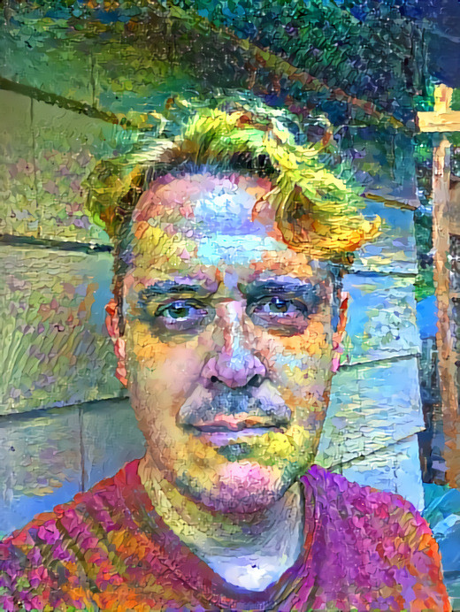
Dr. Brian Stiltner Some final thoughts…
3

Slide 14
Make use of your faculty and the programs here
Take challenging classes. Take upper-level and smaller classes. Take all the full-time professors in your department.
Do more than is required of you in your classes. It’s not about good grades; it’s about good work.
Write research papers. Make sure you’ve had some chances to do lengthy, well-researched papers in your field.
See what research projects you can get involved in with your professors.
Explore internships. State your interest to one or more professors and see what ideas they have.
Develop skills. Even when not specifically required in your field, they round you out as a person and open new doors. For example, study a foreign language, take a technology course, learn some graphic design or video editing skills, etc.
Present at student conferences and attend professional conferences.
Ask your professors to mock-interview you before you have admissions interviews.

Slide 15
This kind of networking…
prepares you to study in the field,
gives you a good sense of the field, of its well-known faculty and programs, and
gives your professors specific things to write about in their recommendation letters.

Slide 16
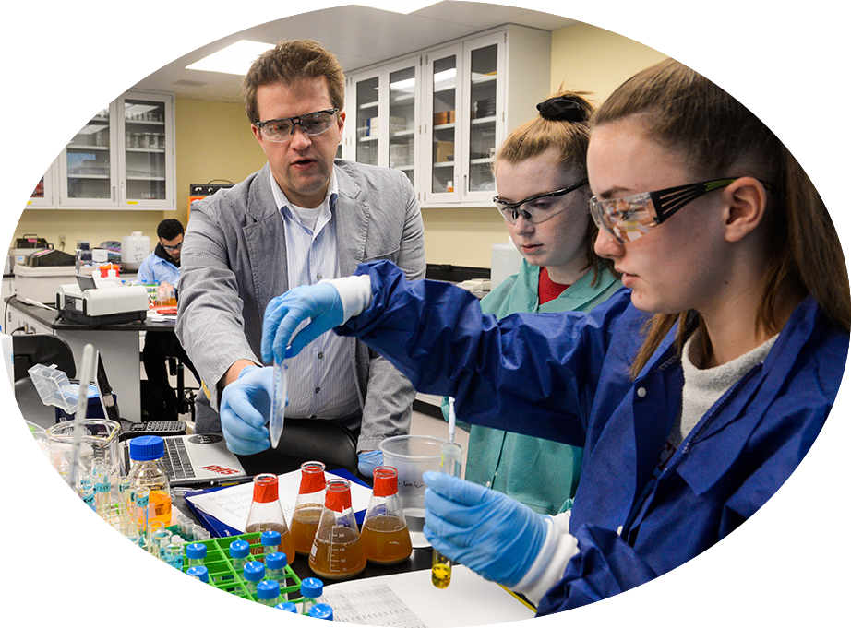
We look forward to your questions.
Thank you!

