Slide 1
Energy 101 : Industry and Recruiting Overview
Rice Business Energy Association
September 12th, 2018

Slide 2
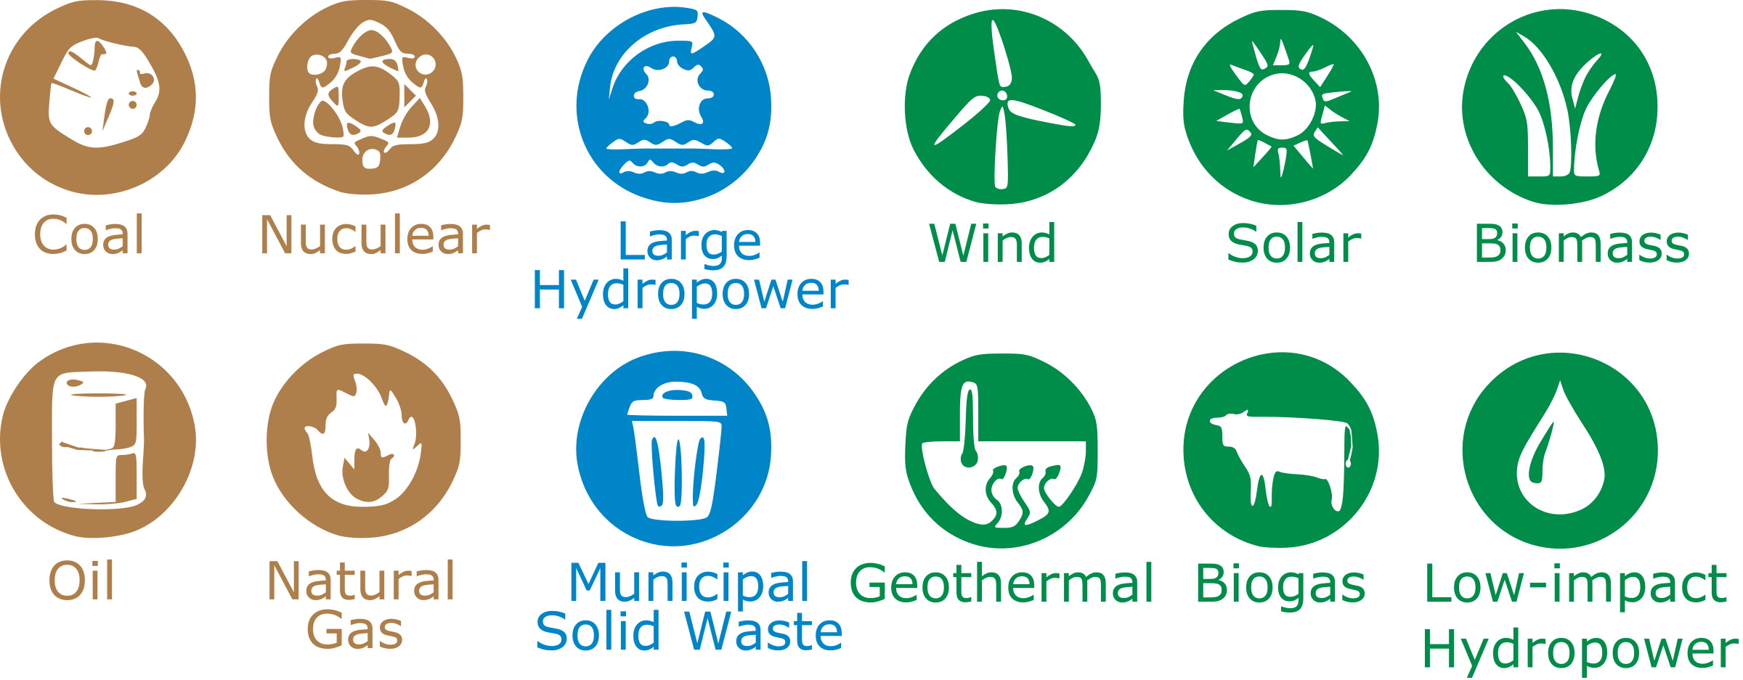
There’s no single source of energy
Notes:
Aka E&P
hydrocarbons’ path upward is blocked by a layer of impermeable rock, such as shale, or by some other geologic formation. These trap the oil and natural gas, either in an underground pocket or in a layer of reservoir rock, so that it may be recovered only by drilling a well.
There isn't any way to be absolutely sure where new oil and natural gas reserves are located, so petroleum engineers need to collect clues as to what lies deep beneath the earth's surface. Advanced technology has revolutionized the exploration process for oil and natural gas, and helps them pinpoint potential reserves with greatly improved accuracy. This results in fewer wells, and lowered exploration costs.
Rock and fluid properties are analyzed through drill cuttings, core samples, and well logging to determine how much oil and natural gas can be recovered from a reservoir.

Slide 3
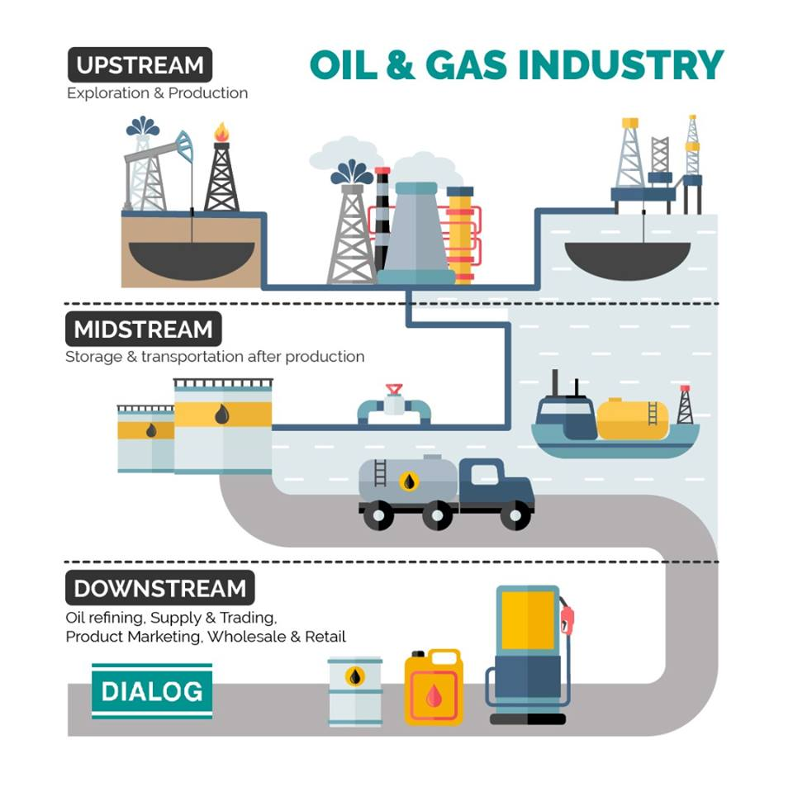
Conventional resource value chain
Upstream involves everything related to finding, recovering, and producing hydrocarbons
Midstream pertains to the transportation of crude oil and natural gas after production, i.e the infrastructure including pipelines and tank trucks
Downstream is the process of converting those hydrocarbons into usable products

Slide 4
Upstream – find and drill
Exploration
Exploration is the process of trying to find accumulations of oil and natural gas trapped under the Earth’s surface
Not an exact science
Seismic surveys and exploration wells
Drilling and Completions
Once a reservoir has been identified as likely to produce hydrocarbons in economic quantities, the next step is drilling
physically creating the “borehole” in the ground that will eventually become a productive oil or gas well
Well completion incorporates the steps taken to transform a drilled well into a producing one. These steps include casing, cementing, perforating, gravel packing and installing a production tree
Production
Wells are completed for production if the value of the recoverable oil and/or natural gas is greater than the cost of drilling and producing them and delivering them to market
Efficiently bringing hydrocarbons to surface so that reserves can be “converted to cash”
Notes:
Aka E&P
hydrocarbons’ path upward is blocked by a layer of impermeable rock, such as shale, or by some other geologic formation. These trap the oil and natural gas, either in an underground pocket or in a layer of reservoir rock, so that it may be recovered only by drilling a well.
There isn't any way to be absolutely sure where new oil and natural gas reserves are located, so petroleum engineers need to collect clues as to what lies deep beneath the earth's surface. Advanced technology has revolutionized the exploration process for oil and natural gas, and helps them pinpoint potential reserves with greatly improved accuracy. This results in fewer wells, and lowered exploration costs.
Rock and fluid properties are analyzed through drill cuttings, core samples, and well logging to determine how much oil and natural gas can be recovered from a reservoir.

Slide 5
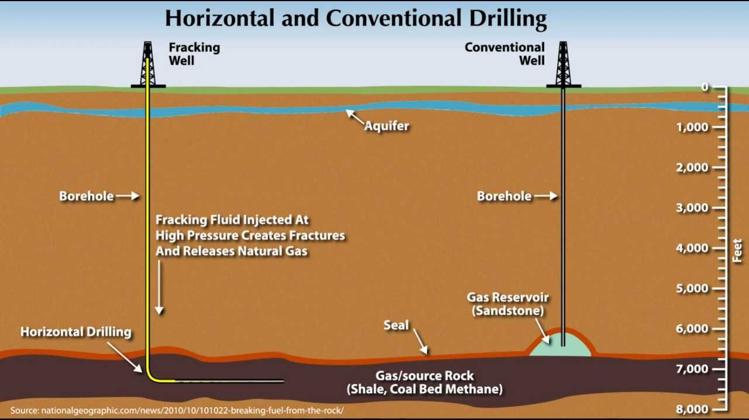
Conventional vs. unconventional
Conventional reservoirs have a relatively high permeability and are easy to extract through traditional means, i.e. vertical drilling
Unconventional reservoirs have relatively low permeability and porosity, and resources must be extracted through non-traditional means, i.e. horizontal drilling, hydraulic fracturing
Advantages of directional and horizontal drilling
Increased ease of access to pay zone
Increased production rate because of the greater wellbore length exposed to the pay zone
Reduced footprint and expenses

Slide 6
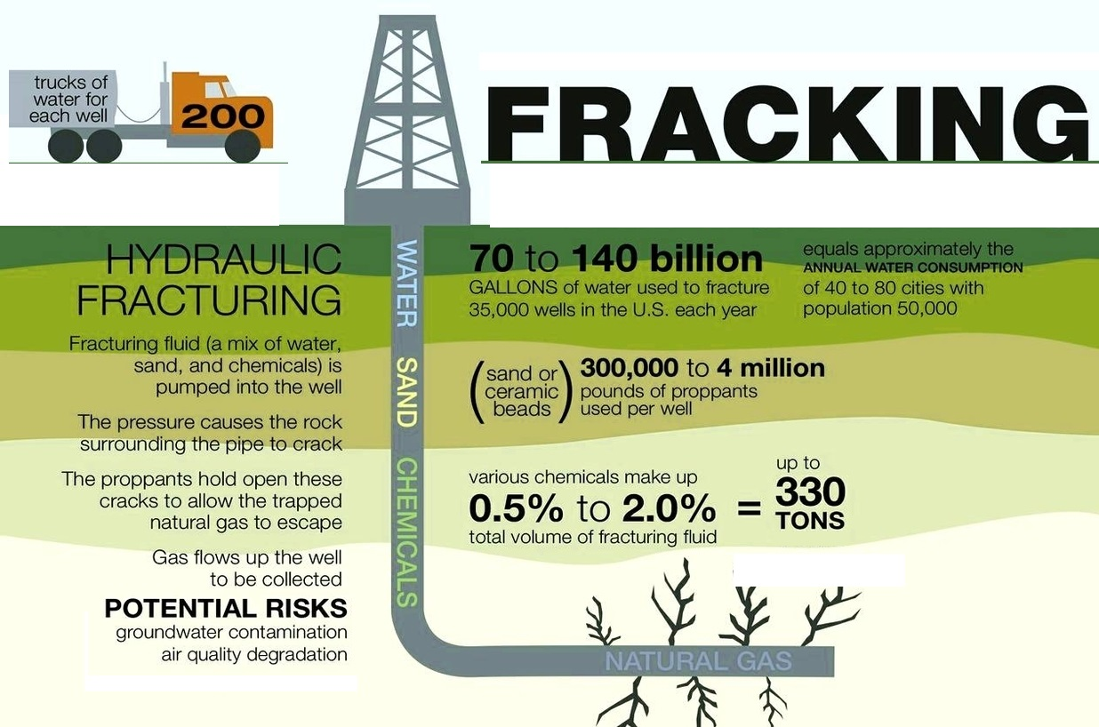
The shale revolution and hydraulic fracturing
The “Shale Revolution” refers to the combination of hydraulic fracturing and horizontal drilling that enabled the US to significantly increase its production, particularly from tight oil formations, which now account for 36% of total U.S. crude oil production
Shale is simply a type of rock deep below the earth’s surface which holds vast deposits of hydrocarbons
Hydraulic fracturing involves injecting a combination of water, sand, and chemicals into the well at high pressures to “fracture” open the rock and allow hydrocarbons to flow to surface more freely

Slide 7
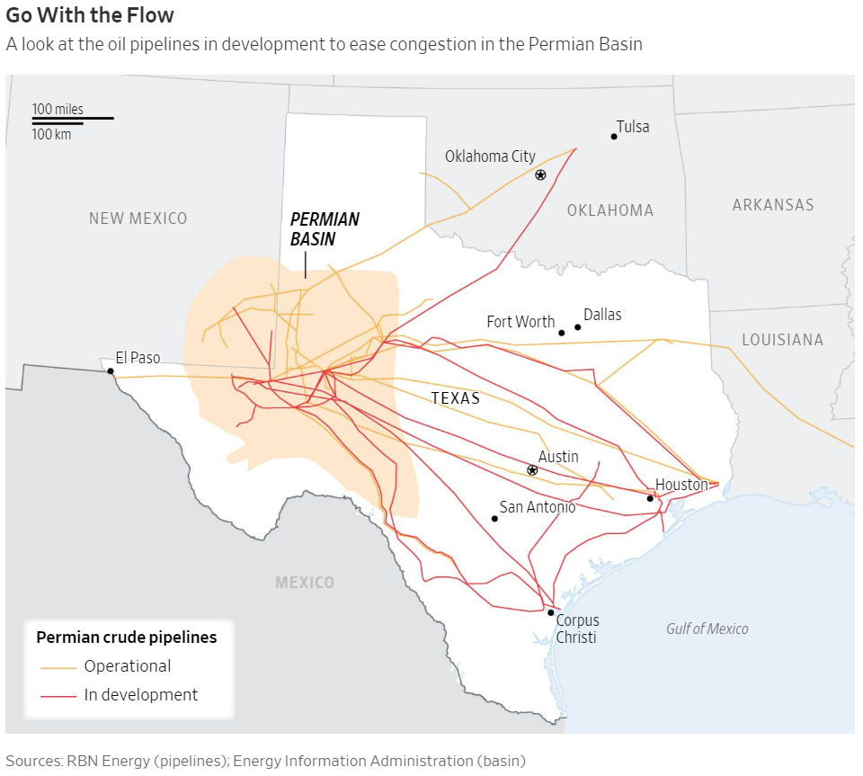
Midstream – transport
The four key characteristics:
Generally low risk
Highly regulated - especially pipeline components
Asset investments are dependent on the health of the upstream
Demand affected by oil and gas prices
Pipelines represent the most common way that hydrocarbons are transported and distributed
Additional modes of transportation include trucking, ships, and rail
Pipeline infrastructure has become the critical bottleneck in the Permian Basin, as production is outpacing pipeline capacity, forcing steep discounts

Slide 8
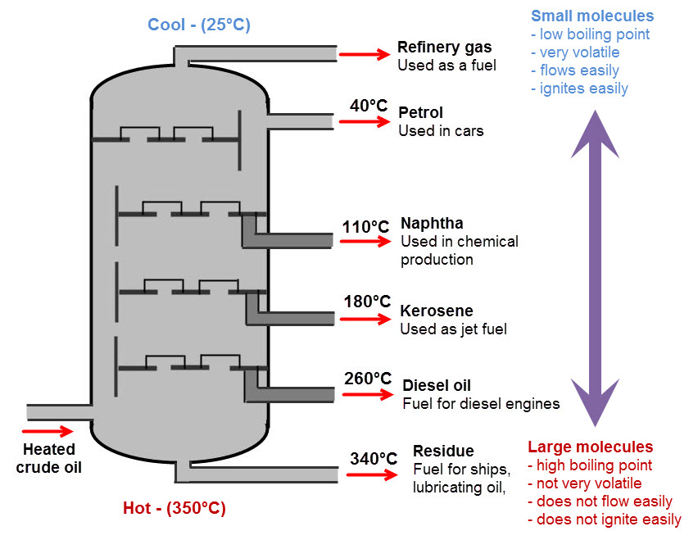
Downstream – refine, distribute & market
Downstream margins tend to be reduced, or squeezed, when crude price increases can not be recovered in the marketplace
On the other hand, margins tend to hold, or even increase, when crude prices drop and the marketplace more slowly adjusts to these lower crude oil prices
The refining process distills and separates crude oil into its various components, which can then be selectively reconfigured into new products by using additional equipment located in the refinery
Separation involves heating crude oil to different temperature levels to separate out the different parts
Conversion involves splitting or cracking heavy hydrocarbon molecules into lighter, more desirable ones
Treating involves blending the separated and converted fractions with other elements to produce final products

Slide 9
End user consumption
Once the hydrocarbons are converted into usable products, the next step in downstream is marketing and selling the finished products to consumers
Gasoline is the most common crude oil product, but other products such as diesel and jet fuel are also sold
Further processing produces lubricants, waxes and specialty products, such as high quality oils for medicines and cosmetics
Raw materials from the downstream are procured for the petrochemical industry as feedstock in the production of thousands of additional products such as synthetic rubber, plastics, nylon, polyesters for fabrics, fertilizers, antifreeze, pesticides and pharmaceuticals
Finally, product marketing is the business of finding and supplying customers who possess either internal demand for refined fuels or wholesale distribution networks for reaching retail customers

Slide 10
Companies
Integrated Oil Companies (Supermajors)
Independent E&P Companies
Oilfield Equipment and Service Companies
Midstream MLPs
Downstream Companies
Utility & Renewables

Slide 11
MBA Roles in the Energy Value Chain
Corporate Finance Roles - Treasury, Controllers, FP&A, Investor Relations
Business Development and Commercial
Strategy
Supply Chain
Trading
Project Management
Marketing
Consulting
Banking
HR
Much More!

Slide 12
Why Energy (Industry) over Consulting/Banking?
Work/Life Balance
PNL Ownership
Career Stability
Cultural Fit
Climb Corporate Ladder and Build Network
More Tangible Impact
International Experience*

Slide 13
Recruiting Process
Recruiting starts now!
Contrary to popular belief, coffee chats aren’t exclusive to consulting and banking
Don’t think of it as a way to check the box, but rather as a way to learn more about the company and culture
At the very least, decide between consulting and banking now. Energy recruiting has a later timeline and can be managed in addition to one of the above
Ask thoughtful questions that you can’t just find online, and try to create advocates through your interactions and conversations
2nd years are good first touch points to practice pitch and get honest responses
Don’t worry about the interview for now, but start thinking of your story for why energy, why X company, why X role, what long term goals etc

Slide 14
Second Year Energy Interns
First | Last | Company
Benjamin | Bailey | CenterPoint Energy
John | Clarke | CenterPoint Energy
Panpim | Lohachala | CenterPoint Energy
Kenneth | Boothby | Concho Resources
Shrish | Ankur | EDF Renewables
Timothy | Barnhill | ExxonMobil
Prathima | Reddy | ExxonMobil
Mitchel | Robertson | ExxonMobil
Gle | Park | KBR
Andrew | Patrick | Kinder Morgan
Alexander | Poulos | Shell
Yan Nick | Naroditski | Stallion Oilfield Services
Austin | Peterson | Stallion Oilfield Services
Ashrit | Shetty | Chevron
Vishruti | Jakhar | Joulon
Jingwen | Wang | WoodMac (Consulting)
Priyal | Khurana | WoodMac (Consulting)
Vipul | Singhal | Westney (Consulting)
Sarah | Brock | Westney (Consulting)

