Slide 1
Internship search strategy Energy club 2015-16
Nick Girardi
September 24, 2015

Slide 2
Agenda
Keys to Success
Hustle and focus
Schmooze
Work the process
Recruiting Process
Identify target list
Develop story
Reach out
Info sessions and treks
Apply and interview
General Best Practices

Slide 3
Hustle and focus
Recruiting starts NOW
Pay it now or pay it later
1st semester chaos
April panic
Personal touch matters
You don’t have to go to every info session
Identify what you want to do and stick to those sessions

Slide 4
Schmooze
Fear nothing and no one
Shyness is for losers
Won’t get internship via coffee chat/trek, but you may lose one
12 am test
Likeable and pleasant
Good questions (not overly technical)
Small talk is a skill

Slide 5
Work the process
Don’t let the process work you
Easy to get overwhelmed
Target
Identify targets
CMC list
Touch Points
Identify and make touch points
LinkedIn
Profit
Get an interview
Get a job
Hoovers
Undergrad recruiting list
LinkedIn
Alumni database
Intro email, then phone call/coffee chat
Get a campus visit

Slide 6
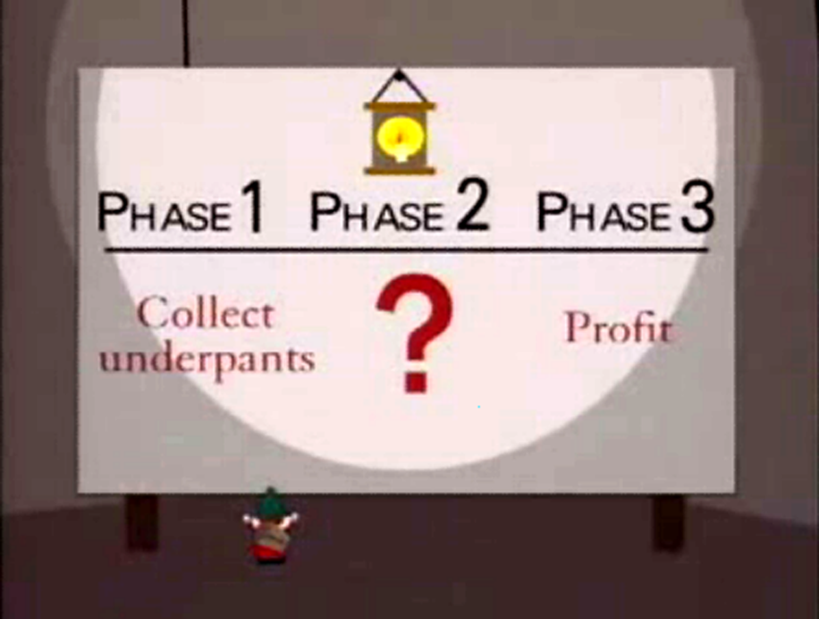
Recruiting process checklist
Identify target list
A list (2-5 firms)
B (1-3)
C (2)
Develop story
Ongoing
Why Energy
Reach out to 2nd years and alumni at targets
30 minute phone call or coffee
A list (5-7), B (3-5), C (1-2)
“Who else should I talk to?”
Attend information sessions
Apply and Interview (session in November)

Slide 7
Identify target list
Sources
List of 2nd year/FT positions
Fortune 500
Top recruiters from your undergrad
Diversify your application portfolio
OK to be change over time
Ex. Anadarko, Ball Corp
Use CMC spreadsheet
Ex. Nick’s target list

Slide 8
Develop story
Get in place now so ready for interviews
Ask coffee chats to listen to your story and help you refine
Nick’s Why Energy Story
Fracking in Northern Colorado
Center of industrial world
Complex geopolitics
Growth opportunities
Specificity to firm

Slide 9
Info sessions and treks
Identify your position (corporate finance, business development, strategy, etc)
Cross off or focus on Consulting or Investment Banking ASAP
2-3 sessions per week max
Goals
Identify a name
Don’t say dumb stuff
Ask good questions that provoke more talking
Exercise: the half moon with a crappy conversationalist

Slide 10
Side note: bs-ing during info sessions
How did you end up at [insert firm name]
What’s your day to day like?
How has [insert firm name] reacted to [whatever event just happened]?
When were you at Rice? Any recommendations for the first semester?
What have you been working on?
Are you from Houston? How do you like the city? I’m not from here…what do you recommend I see or do?

Slide 11
Reach out to 2nd years and alumni
Sources
2nd years
CMC
Alumni database
LinkedIn
Email for info interview
Informational interview
Best practices
OK to do over phone
Shoot for 3-4 per week
If they invite you to office, GO!
Emails
I’m a first year MBA at Rice University. We met at [blah] or I found your information on [blah]. I’m writing to ask if you have time for a 30 minute phone call or coffee to discuss your experience at [blah].
Questions to ask during
Why firm?
Why energy?
Why role?
What are your long term goals with [blah]?
Who else do you I recommend I talk to?

Slide 12
International considerations
Additional Filter:
International Alumni list
List of companies with history of hiring international students
Better to shortlist early than repent later
Talk to 2nd year international students. Learn from their experience & resources
Share information with international classmates. Don’t compete against each other
Diversify your risk. B,C,D list
Start early and don’t panic. Everyone gets an internship
Notes:
Additional Filter:
International Alumni list
List of companies with history of hiring international students
Better to shortlist early than repent later
Be wiling to look at all career tracks that may lead you to your long-term aspirations.
Talk to 2nd year international students. Learn from their experience & resources.
Share information with international batch-mates. Don’t compete against each other.
Diversify your risk. B,C,D lists – that includes other companies and industries.
Start early and don’t panic. Everyone gets an internship.
On a side note, it cannot be stressed enough on how important networking and good communication skills are. Start working on it early.

Slide 13
Apply and interview
Interview session to follow in November
Use answers from chats to drive your preparation
Why Energy?
Why [firm]?
Why [function]?
Example: XOM
Leadership
Humility
Mobility
Tell me a time when…
You tell me what is important
I tell you that it is important

Slide 14
General best practices
2nd years are Yoda
Don’t go to every info session/trek, but go to a lot of them
Weekly reminder to work on Target list
Send emails to schedule calls
Prune & grow
GPA: 3.5+ for certain firms
Best practices from PSX Recruiter
Be smart, not arrogant
Show me how you think
Be flexible with your long term goals
I am interested in these skillsets: finance, modeling, controllers
Someday, I could see myself as the controller, but am open to different positions

Slide 15
FT Energy Employment by function

Slide 16
Total energy employment

Slide 17
Stay positive. It gets easier. Work backwards.
YOUR SUCCESS DEPENDS ON YOUR EFFORT

