Slide 1

LEVERAGING
LinkedIn
CAREER DEVELOPMENT OFFICE

Slide 2
SESSION OVERVIEW:
LinkedIn Purpose & Basics
How Recruiters Use LinkedIn
LinkedIn Walk Through
Building Your Optimal LinkedIn Profile Brand
Making the Most of LinkedIn
LinkedIn for Job Seekers

Slide 3
Purpose & Basics of
LinkedIn

Slide 4

Hello!
LinkedIn is your living resume that is always on display.
Digital representation of your professional profile and brand.
575 million+ users in 2018!
A key tool used by recruiters, headhunters, and hiring managers to identify, recruit, and verify candidates.

Slide 5

Your public profile comes up in search engines, allowing people not logged in to the site to view your profile

Slide 6
Background
HOW RECRUITERS USE LINKEDIN

Slide 7
LinkedIn from a Recruiting Perspective
LinkedIn = Niche Recruiting
Keywords & Completeness
Skills, Technology, Trust Indicators
Posting Jobs & Headhunting
Notes:
Headline and Job Titles
The profile headline and recent job title are weighted heavily in LinkedIn’s search algorithms as well as recruiter behavior. A recruiter is likely to begin their search with specific job titles, and candidates with a matching job title in their headline and experience headings will appear higher in results.
The headline is the first major piece of information seen in search results alongside the name and profile photo. You have 120 characters to use in your LinkedIn headline, plenty of space to communicate exactly what you do, your specializations, and/or what role you’re pursuing.
Keywords
Past experience can give recruiters and hiring managers a good idea of a candidate’s capabilities, but they are highly likely to search for specific skills or keywords as well, either by using LinkedIn Recruiters built-in skills filtering or by plugging all relevant terms into the search bar.
“I go into a keyword search and put in different buzzwords that I pull from the specific job description,” says White. “If I was looking for a front end developer, I would put in Javascript, CSS, HTML, HTML5…”
Skills filtering in LinkedIn Recruiter (Data Scientist).Keywords make the biggest impact on LinkedIn search ranking when they appear in a profile headline or job title, but can also be placed in job descriptions and the LinkedIn profile summary. Skills and keywords listed in your “Skills & Endorsements” section are searchable but not weighted as highly as keywords in other sections.
Location
“When I searched for candidates in LinkedIn Recruiter, I’d typically begin with the location,” said White. “I’d keep it under a 20 mile radius. Sometimes I would even [search within] five miles.”
Recruiters aren’t only looking for the right skills, they’re looking for candidates who are likely to accept the job offer. Because of this, some recruiters are more likely to target local candidates at the beginning of their search.
You can’t qualify for localized searches without adding your location on your LinkedIn profile. Similarly, listing your current location rather than the city in which you’d like to work can have the same effect. Explaining to a recruiter that you are willing to commute or relocate is more effective than hoping they search broadly enough to find you.
You should also specify which cities you’re willing to relocate to in your “Career interests” settings. When logged into LinkedIn, click “Jobs” in the top navigation bar, then “Career interests” under the search bar to update your location preferences and other settings.
Profile URL
LinkedIn profile default URLs are tidier now than they were in the past, but users are still wise to customize.
Creating a custom URL has benefits beyond the minimal effect it might have on a user’s ranking in LinkedIn search results. It looks better when included on a resume and helps your LinkedIn profile carry more weight in external search results . If a recruiter or hiring manager googles your name and position, a custom URL can help improve your profile’s rank. For example, change the default “…/john-doe-08b73111b/” to “…/john-doe-san-francisco” or “…/john-doe-project-manager”.
What else is keeping recruiters from finding you?
Measurable results
Bullet points are good, but knowing what you really did and accomplished is even better.
Job hopping and temp gigs that should be explained
“If they have changed jobs every year for the last five or six years, what’s gonna keep them here?”
Complete education info
As with location, forgetting to include your complete educational information (including grad date) could cause you to be filtered out of search results right off the bat.
Number of connections
The more common connections you have with a searcher (recruiter or hiring manager), the higher your profile will be in the results when they search words relevant to your profile. Recruiters can also specify degrees of connection in their searches. The more connections you have, the more likely you’ll be a 2nd degree connection to a recruiter.

Slide 8
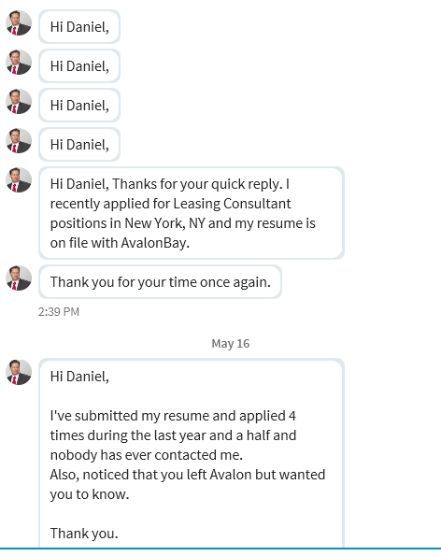
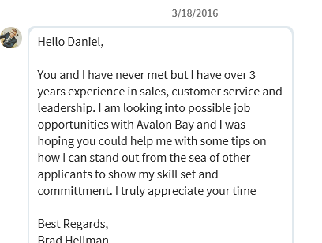
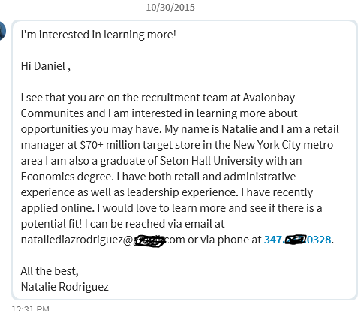
A recruiter’s perspective…

Slide 9
Demo
LinkedIn Walk-Through
Notes:
Basic components
Privacy settings
URL
Where to find everything – alumni, jobs, groups, messaging through groups trick

Slide 10

Take Action
Building your optimal LinkedIn profile brand

Slide 11

Step 1: Research
Target keywords for roles/industries of interest to you & identify transferable skills & overlap in current experience
Resources include:
  Job postings
  CDO keyword lists
  Word cloud websites like tagcrowd.com

Slide 12

Step 2: Draft your headline, summary, and experience bullets

Slide 13

WRITE YOUR SUMMARY
Stuck? Consider the Following:
What are your goals and ambitions?
What are your strengths?
What are your guiding principles?
Why are you passionate about your current job or industry/target job/industry?
Were there any specific pieces of wisdom that you took away from past jobs?
Is there any unique knowledge you’ve brought into your industry from other life experiences?

Slide 14

Aesthetic Elements of LinkedIn

Slide 15


Profile photo: inviting professional headshot
Free headshots @ Career Expo!
Adding color to your LinkedIn
Color Icons for LinkedIn - Just Copy & Paste!
Background photo: quote, industry-related, simple

Slide 16
Aim for 90-100% completeness
Add groups, volunteer experiences, skills, and other accomplishments
Enhance your LI presence:
Aim to post on your feed 1x week
Post to a group/respond to a post 2x month or more

Slide 17
THANK YOU!

