Slide 1
Consulting 101
Session 1: What is consulting?

Slide 2
Consultants answer the questions and perform the tasks their clients can not
Consultants provide expertise and guidance across a number of areas:
Management
IT/Risk
Human Capital
HR
Implementation/Program Management

Slide 3
Consulting firms come in all shapes, sizes and specialties
Big Three
Big Four
Vault Top 10
Boutique/Specialty

Slide 4
Projects span industries and functions
Consumer Packaged Goods
Healthcare
Financial Services
Oil & Gas
Power & Utilities
Public Sector
Retail
Social Sector
Technology/Media/Telecomm
Analytics
Digital
Finance
Marketing
Mergers & Acquisitions
Operations/Supply Chain
Product Commercialization
Shared Services
Strategy

Slide 5
The typical consulting hierarchy*
Partner
Senior Manager
Manager
Senior Consultant
Analyst
* Firms may have different names and additional levels above or below partner

Slide 6
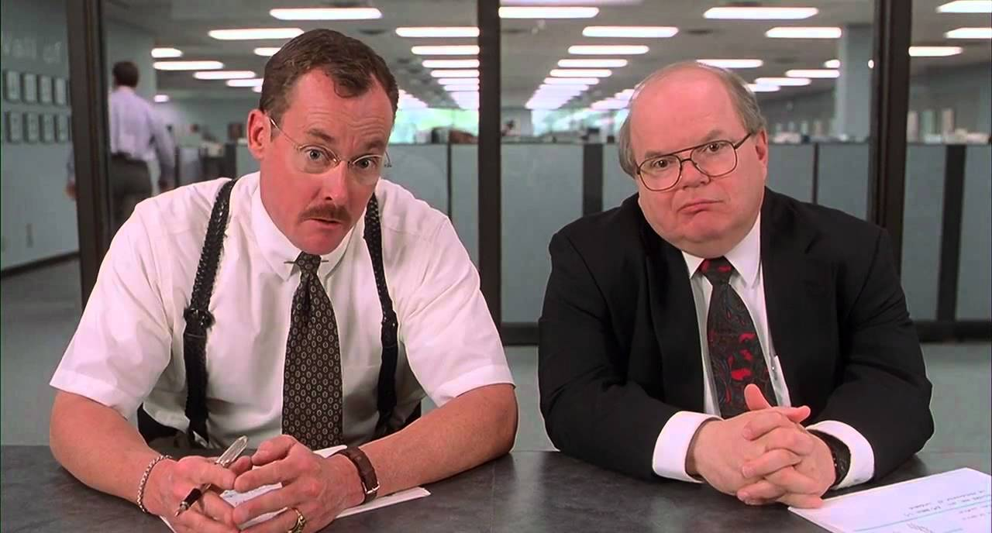
What would you say you do here?
Attend a shit load of meetings
Status meetings, PMO meetings, brainstorming, training, etc.
Deliverables
Excel, PPT, Word, Visio, Tableau
Relationship Management
Client relationship building
Internal networking
Travel
Monday morning flight out (The airport is surprisingly busy at 6AM)
Thursday afternoon/evening flight home
Points, points, points

Slide 7
2nd Year Spotlight
David Laborde
Edward Coles
Samir Khatani
Ming Chang

Slide 8
What are firms looking for?
All kinds of backgrounds (engineering, teaching, finance, business, sales, music, etc.)
Analytical skills
Strong GPA (3.5+)
Strong test scores (High 600s)

Slide 9
Recruiting Timeline and Statistics
 | September |  | October | November | December | January
Information Sessions
Informational Interviews
Case Prep
Interviews
Only about 25% of students that applied for consulting positions received internship offers.
Have a plan B
If you’re committed, then take it very seriously. And still have a plan B.

Slide 10
Where to find more information
Consulting club CampusGroups site
Books
Case in Point, Marc Cosentino
Case Interview Secrets, Victor Cheng
Crack the Case, David Ohrvall
The Pyramid Principle, Barbara Minto
House of Lies, Martin Kihn
Victor Cheng online resources:
www.caseinterview.com (good math practice)
https://www.youtube.com/watch?v=fBwUxnTpTBo&list=PLL1jLM18SWP1uF1ReVpWY9MSpFXWdmEfW&index=1
Other websites:
Firm-specific information: www.managementconsulted.com
Vault Insider (free membership from CMC)
Bain sample case interview: https://www.youtube.com/watch?v=Nib4_5_4afA

Slide 11
Some of the Summer 2017 Internships
Name | Internship Employer | Email
Robert Elliott | Deloitte | Robert.Elliott@rice.edu
Jordan Fox | Deloitte | Jordan.d.fox@rice.edu
Ahmad Ramadan | North Highland | Ahmad.Ramadan@rice.edu
Zachary Harris | North Highland | Zachary.m.harris@rice.edu
Alexandre Silva | Deloitte | Alexandre.r.silva@rice.edu
Sowmeya Subramanian | EY | Sowmeya.Subramanian@rice.edu
Ming Chang | EY – OTS | Ming.chang@rice.edu
David Laborde | Kalypso | David.f.laborde@rice.edu
Samir Khatani | EY | Samir.Khatani@rice.edu
Sonny Nguyen | BCG | Sonny.Nguyen@rice.edu
Edward Coles | McKinsey | Edward.m.coles@rice.edu

Slide 12
Info session and Networking Basics
Visit the website before an info session
Make sure to RSVP and sign in
Wear a suit
Stay off your phone
Don’t hog the recruiters’ time
More to come on this next week…

Slide 13
Next Week and Outstanding Items
You don’t need to start coffee chats yet (September/October)
Don’t fret over case interview prep yet (September/October)
Next week: Recruiting 101
Timelines
Differences between firm hiring processes
Prep schedules
Coffee chats
Networking
Resumes and Cover Letters

Slide 14
Some upcoming events*
Date | Event
August 30 | Consulting 101 - Recruiting
August 31 | Deloitte
September 1 | North Highland Breakfast
September 5 | Alvarez & Marsal
September 7 | Ernst & Young
September 8 | Consulting 101 – Casing (with special alumni guest)
September 11 | North Highland
September 21 | McKinsey & Company
September 29 | Case Demonstration with McKinsey Alumni
October 18 | BCG
November 15-17 | Deloitte Case Competition
Multiple Dates | Company Coffee Chats (under Mock Interviews)
*NOTE: It is 100% your responsibility to track events and application deadlines
The CDO & consulting club will send announcements, but this is your job/internship search
Some firms do not post in Owl-Careers – this means you need to check their website & deadlines

