Slide 1
Competing Effectively in a COVID-Impacted Job Search
Wednesday, September 9, 2020
Marie Bergeron, Career Development Office
Please keep your audio and video muted.
We will begin shortly.

Slide 2
CAREER SERVICES AT

Slide 3
Fundamentals do not change
Targeting and research
Planning & Recordkeeping
Creating a Solid, tailoring-friendly resume
Building a Robust, aligned, keyword-rich linkedin profile
Networking, networking, networking …and follow-up

Slide 4
targeting
&
research
Notes:
Answers/choices on next slide

Slide 5
Research
Determine target Role
Review Job Postings
Lift Keywords/Phrases
Read LInkedIn Profiles
Build Lexicon/Language
Research Companies
Plan Market approach

Slide 6
Planning & Recordkeeping
Notes:
Answers/choices on next slide

Slide 7
Building a Solid, Fungible Resume
Consider the process
Keywords rule
Rearticulate experience
Tailor per opportunity
Use “Standard” Format
Proofread!

Slide 8
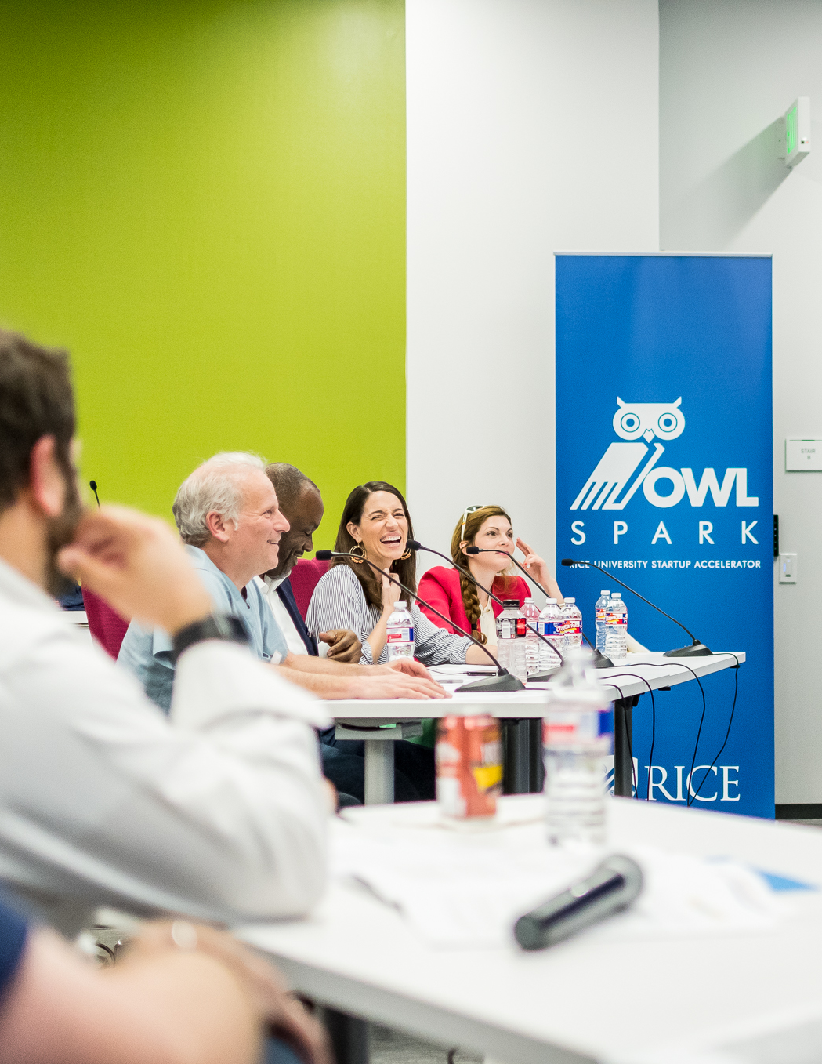
Create a Robust, aligned Linkedin Profile
Notes:
Answers/choices on next slide

Slide 9
Optimized LinkedIn Profile
“bones” match resume
How Recruiters use it
Headline is critical
Keywords rule here, too
First 3 lines of “About”
Broaden network
Learn to use filters

Slide 10
Digital Networking
Strategies
Notes:
Answers/choices on next slide

Slide 11
Digital Networking
Connect with peers
Seek out referrals
Linkedin & social media
Rice Portal
Sallyportal.org
Meetups / virtual events
Video interviews

Slide 12
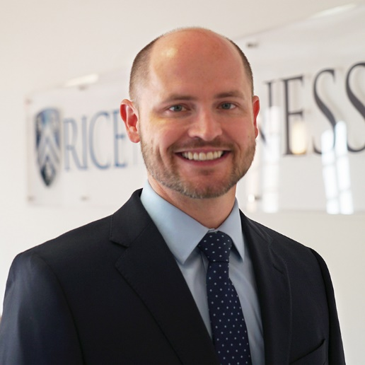
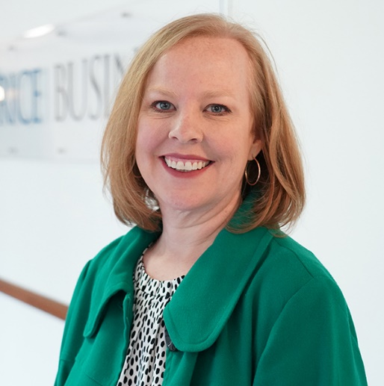
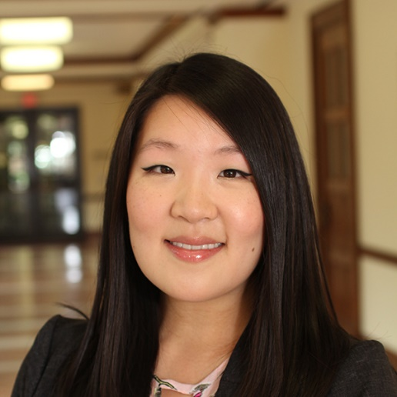
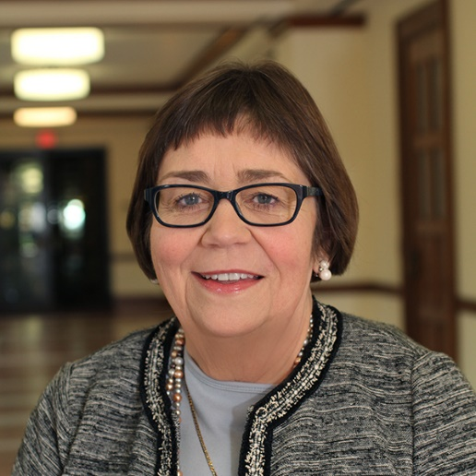
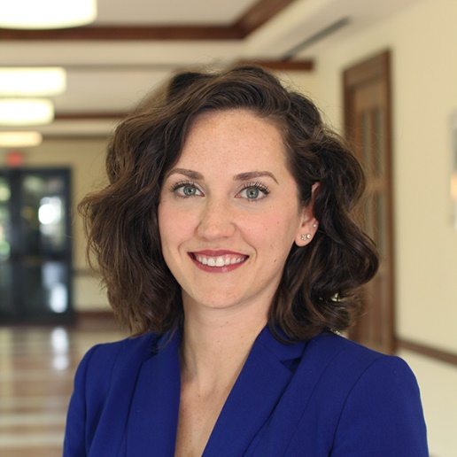
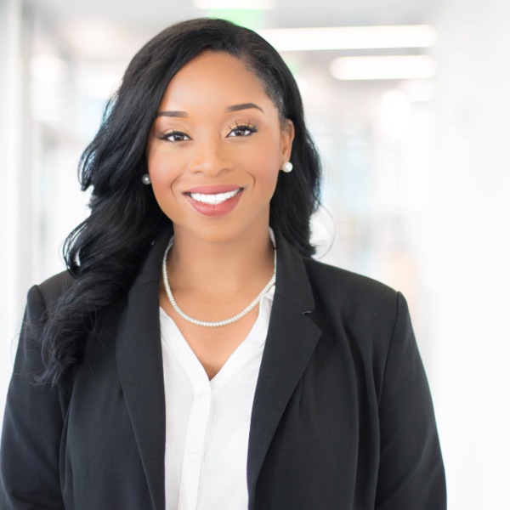
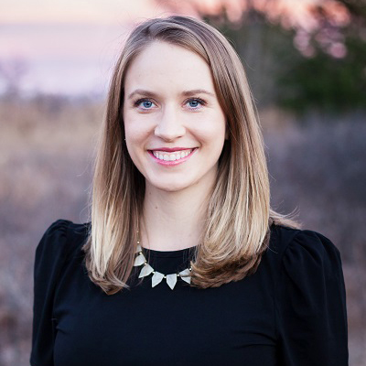
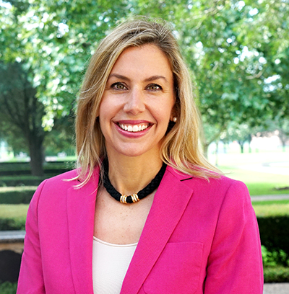
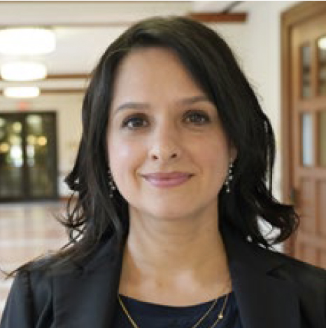
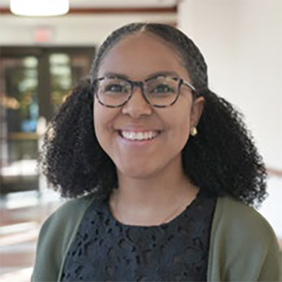
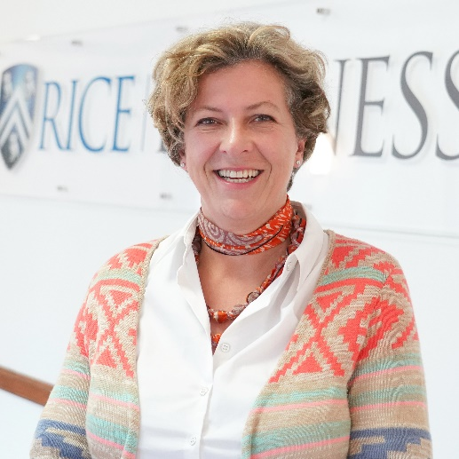
Meet our team
Philip Heavilin
Executive director
Jessica campbell
Director, corporate & employer relations
Tiffany stott
Interim Director,
career education & advising
Marie c. bergeron
Director, experienced hires & alumni
Tamara clarkson
Associate director, career education & advising
Carmen carter
Associate director, recruiting & employer relations
Erin fisher
Associate director,
career education & advising
Ashley mctaggart
Associate director, career education & advising
Schedule Appointments in
Owl careers
Mariella de alba ortiz
Assistant director,
recruiting and employer relations
Darnelle desvignes
Recruiting coordinator, career development office
Stefanie engels
Office coordinator, career development office

Slide 13
Wq

