Slide 1
Navigating "Smart" Talent Management Systems
May 12, 2020

Slide 2
ATS – Applicant Tracking System
Popular Applicant Tracking Systems - Taleo, Workday, Jobvite, Brassring
Used to screen job applicants
Assigns a rating to the resume based on keyword matches

Slide 3
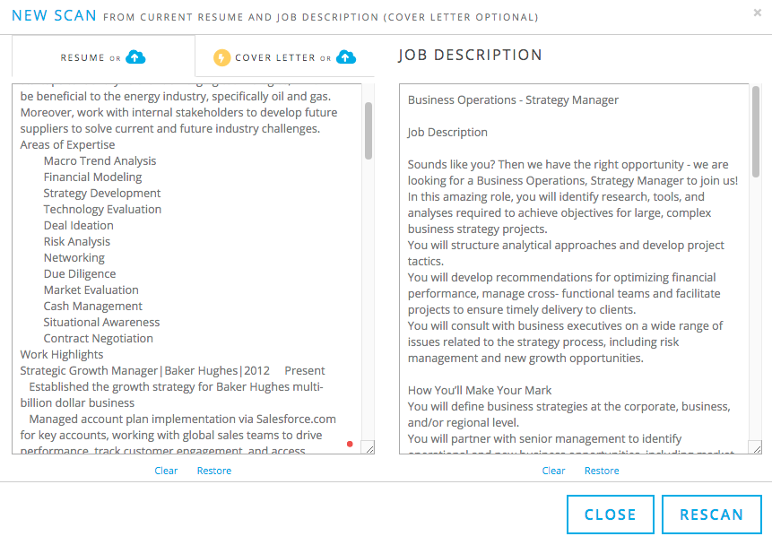
Jobscan – AI for resume
Scans resume and optimizes it for ATS
Online service with Basic and Premium
Basic – 5 scans per month
Premium – unlimited scans
Reviews cover letter and optimizes for ATS
Rates resume based on keyword match for hard and soft skills

Slide 4
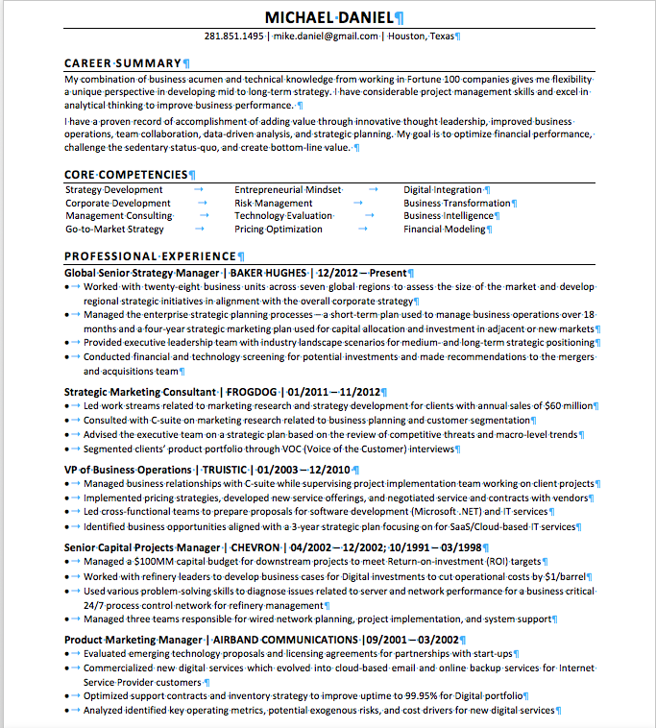
Five Tips to Improve Resume using Jobscan
Format resume
Enter company name and link to job description
Edit resume to match keywords
Update Career Summary
Include Cover Letter with application submission
Goal: Get Resume Match > 80%

Slide 5
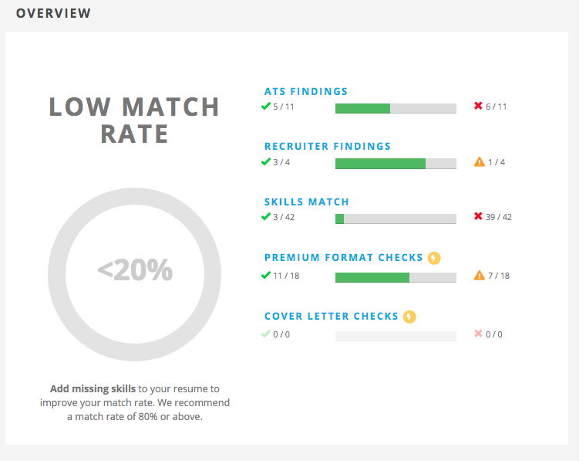
Formatting Tips
1
Consistent margins
Use Sans Serif Font – Calibri or Arial, 10pt
Used clear, concise section headers
Do not use tables, use tabs
Use correct date format e.g. mm/yy, mm/yyyy
Used Bold to highlight job titles and company
Update Career Summary

Slide 6
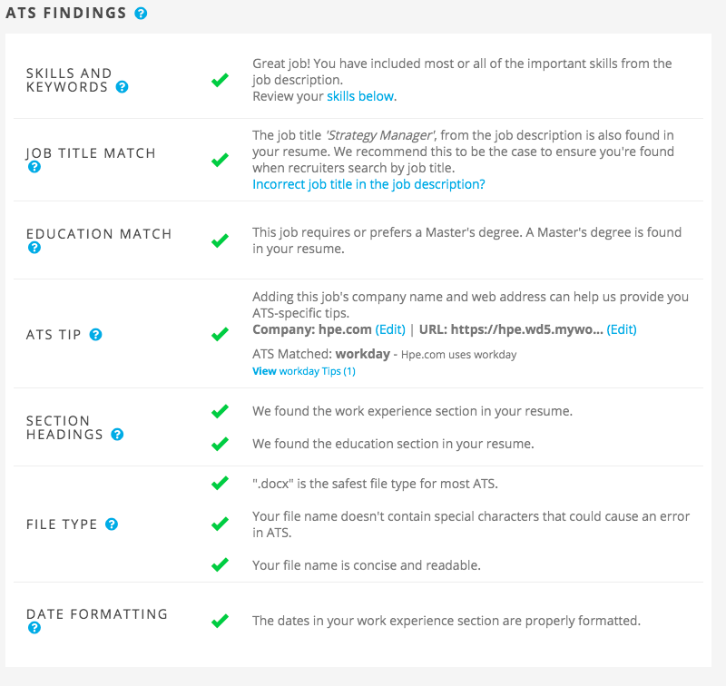
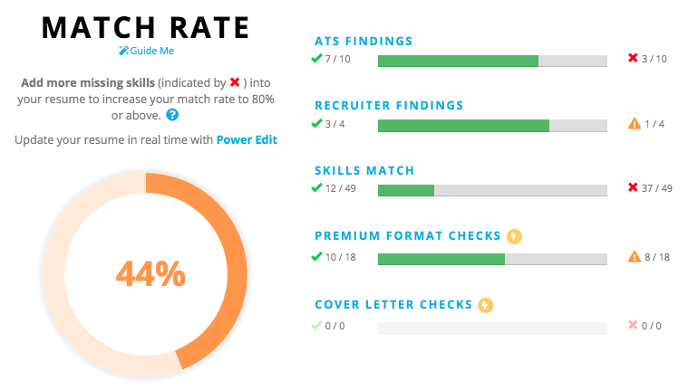
Company Name and Job Description
2
Identifies the ATS in use
Recommends additional tips based on the ATS
Verifies education and job titles
Checks for recognizable section headings
Verifies file type – docx or pdf
Checks for length of file name
No spaces
Less than 30 characters

Slide 7
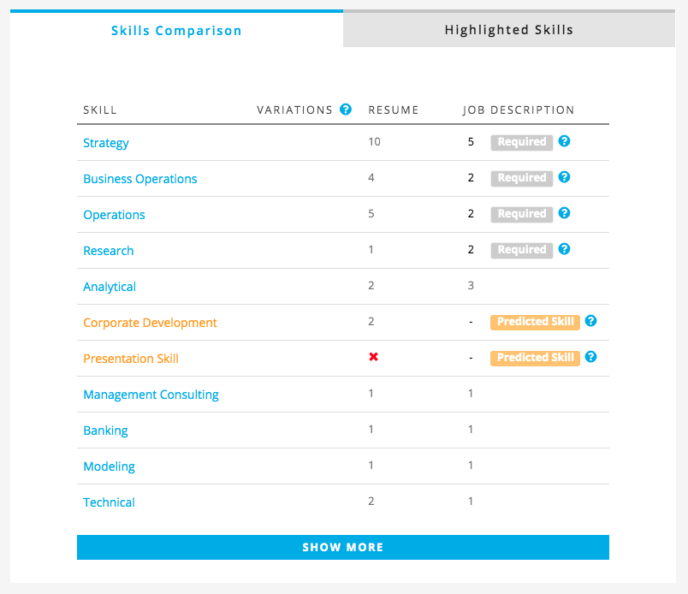
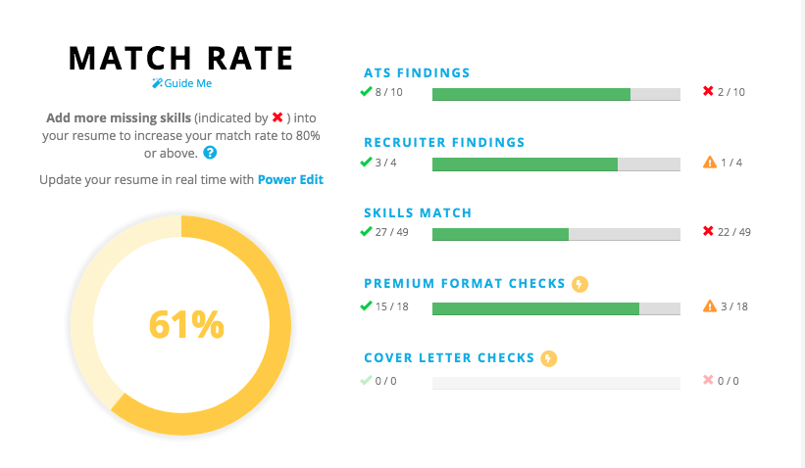
Keyword Matching
3
Scans for hard and soft skills from job description
Edit resume to use keywords
Do not use abbreviations
Be careful with plurals or word variations
Wordsmith to use exact words
Match as many skills as possible
Include company name and job title in resume
Include measurable results

Slide 8
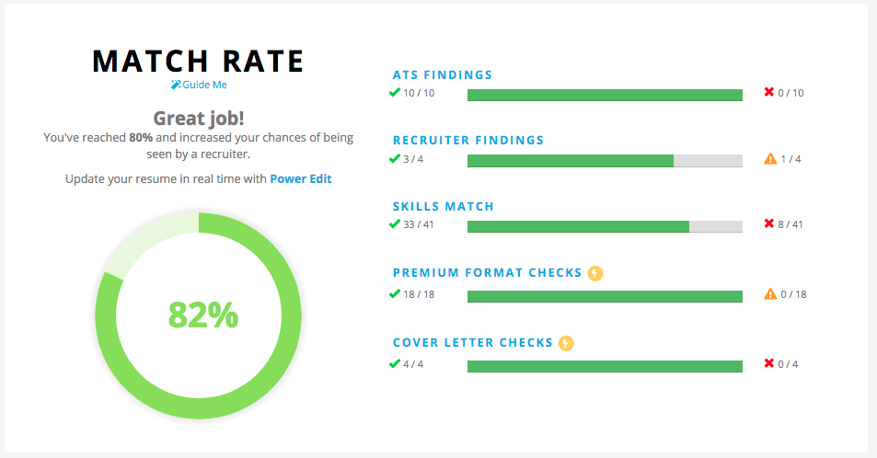
Career Summary
4
Make it clear and concise
Keep paragraphs to less than 40 words
Include soft skills in career summary

Slide 9
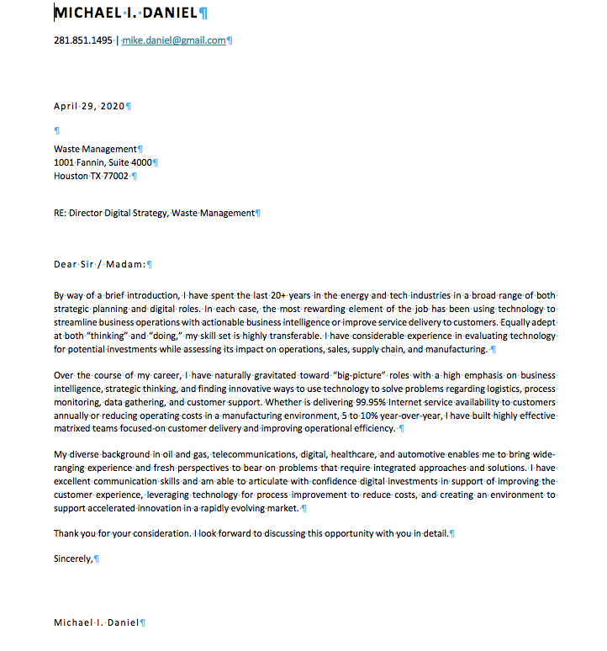
Cover Letter
5
Use company’s address
Keep paragraphs to less than 40 words
Include soft and hard skills cover letter
Add in 2 to 3 measurable results
Include company name and job title

Slide 10
Q & A
Mike Daniel, EMBA ‘12
mike.daniel@gmail.com
@slidemodel
http://slidemodel.com
Notes:
You can safely remove this slide. This slide design was provided by SlideModel.com – You can download more templates, shapes and elements for PowerPoint from http://slidemodel.com

